Slide 1
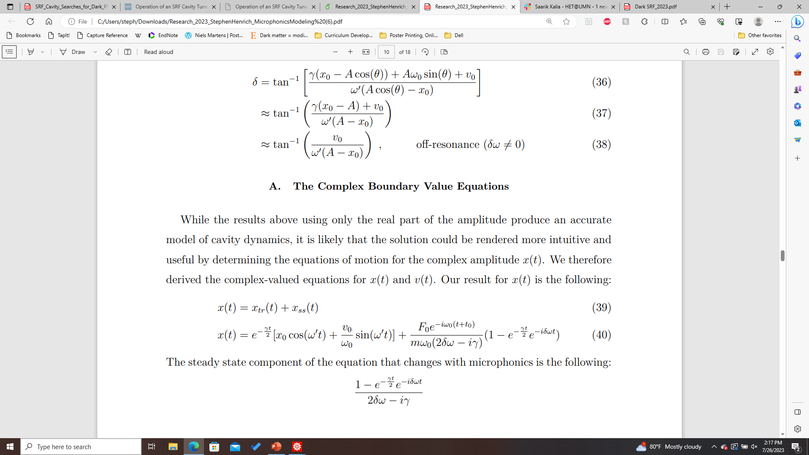
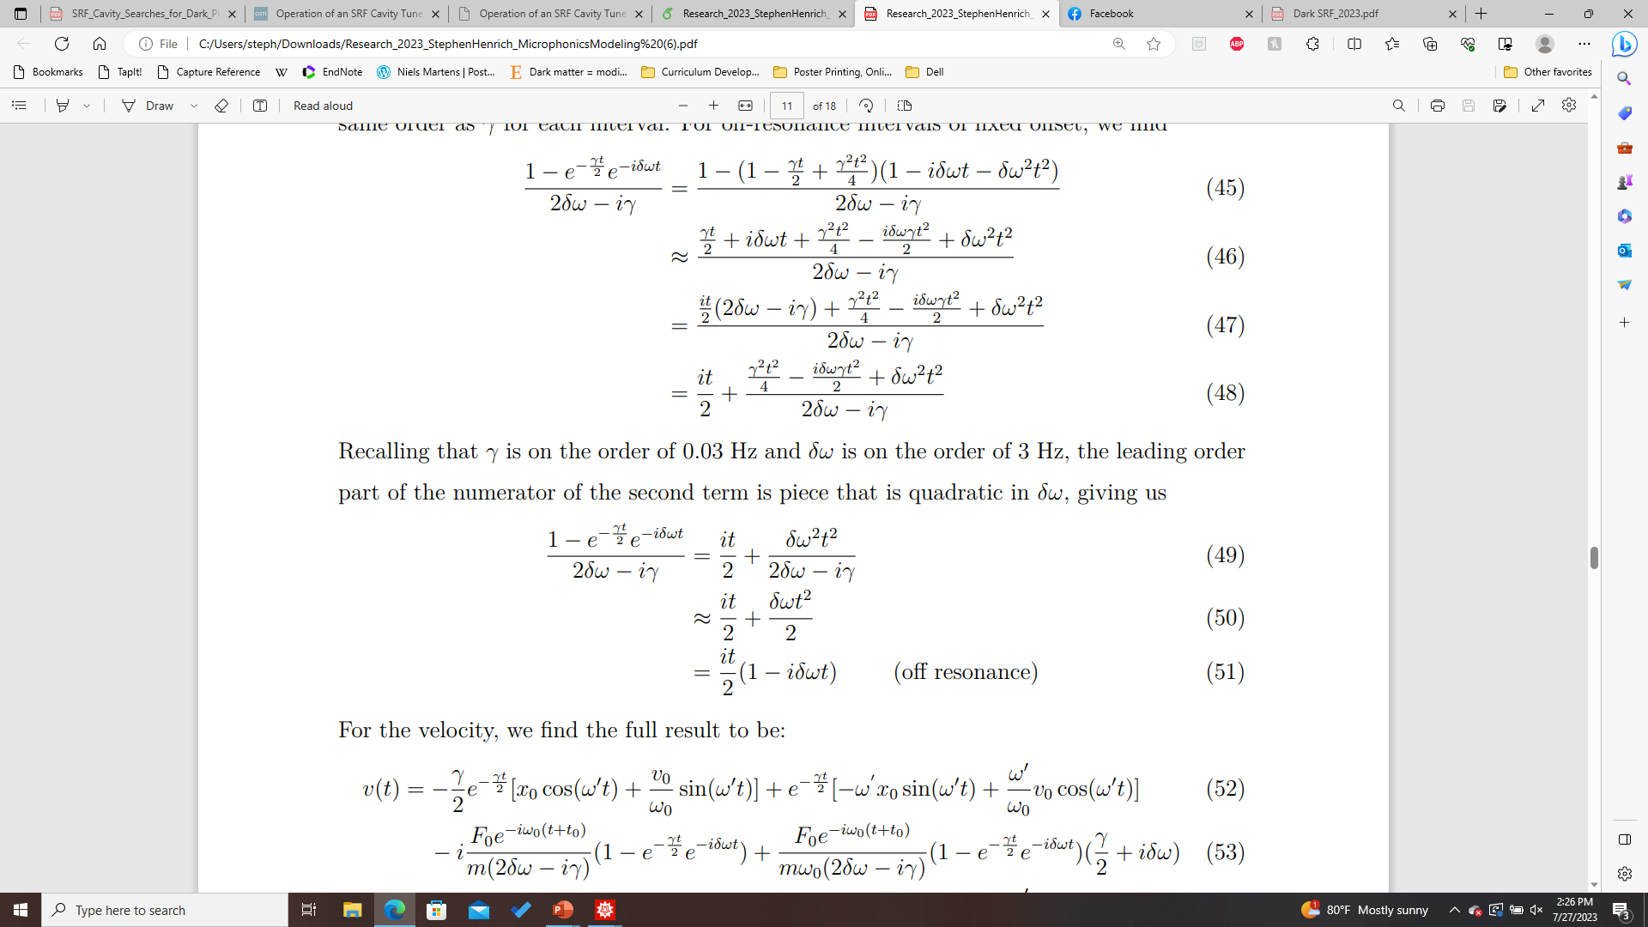
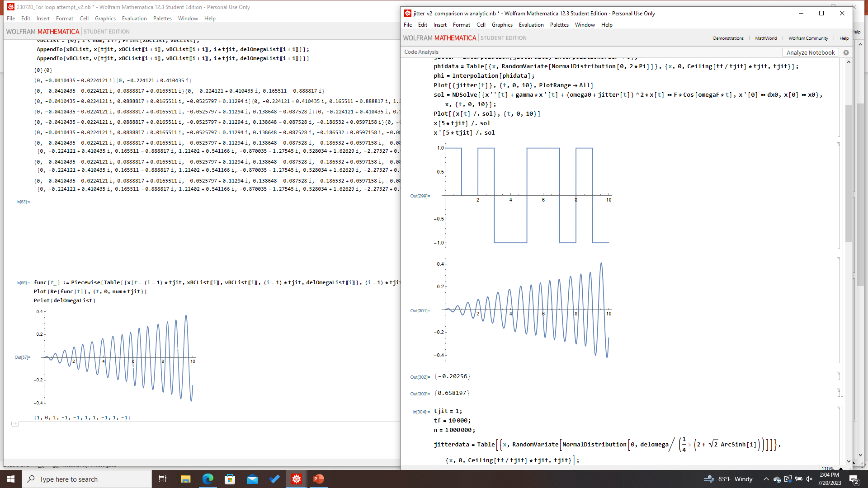
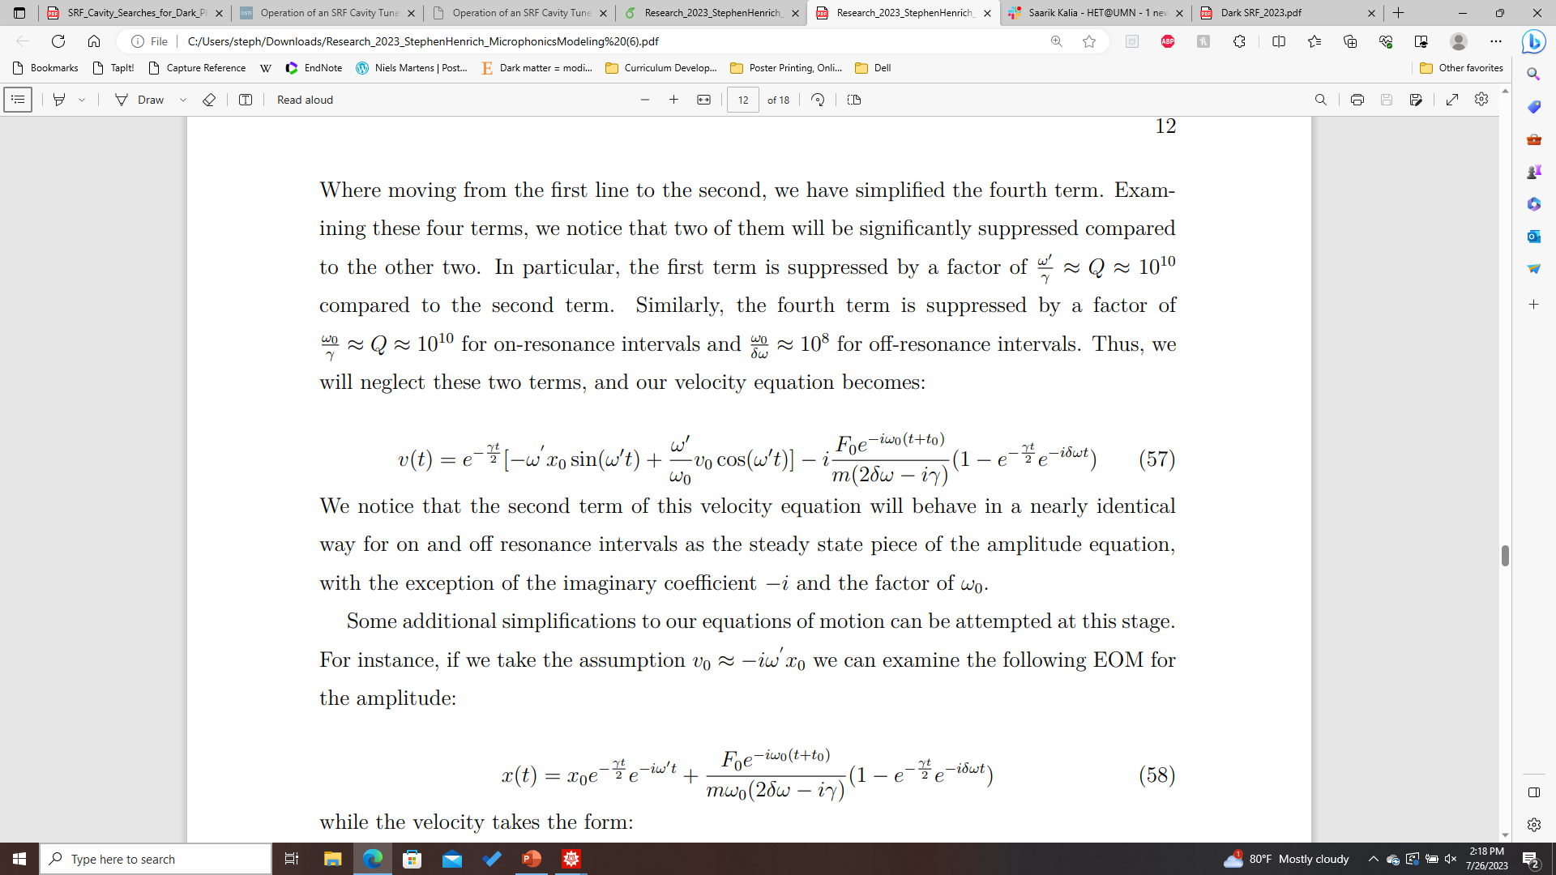
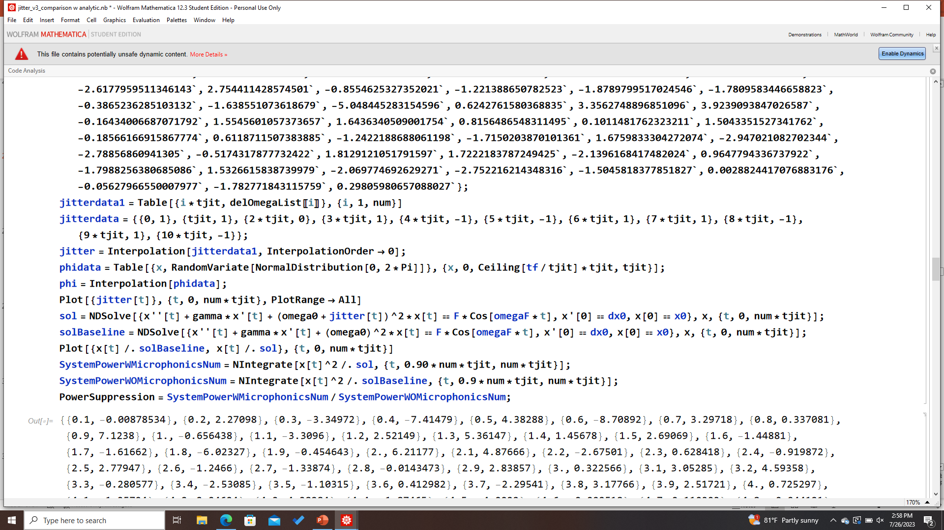
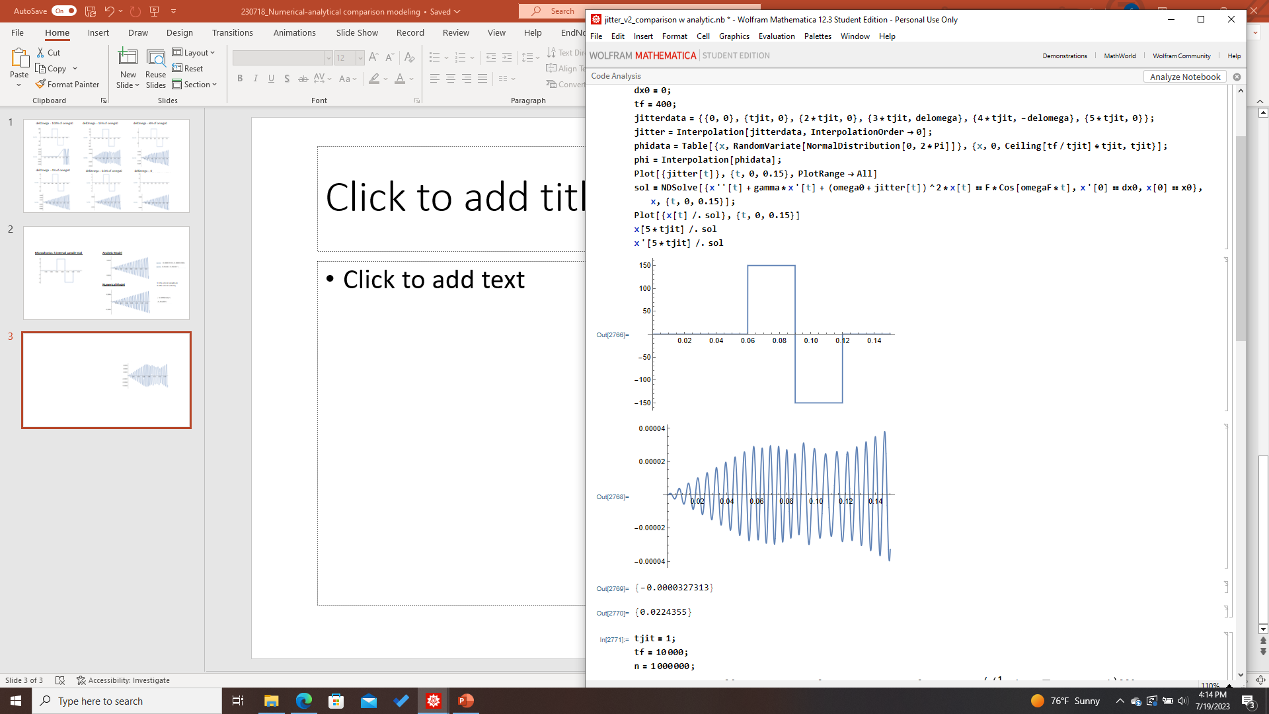
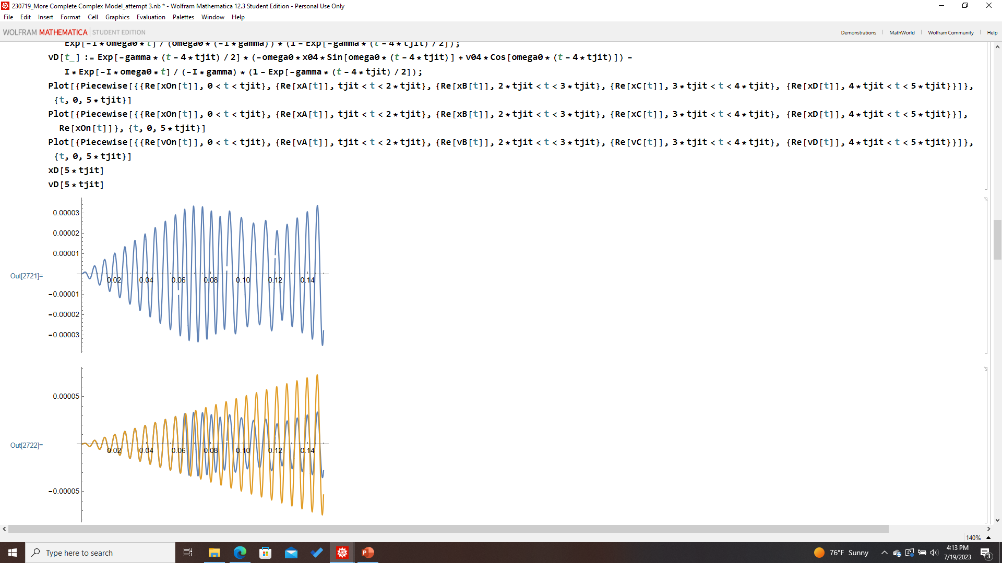
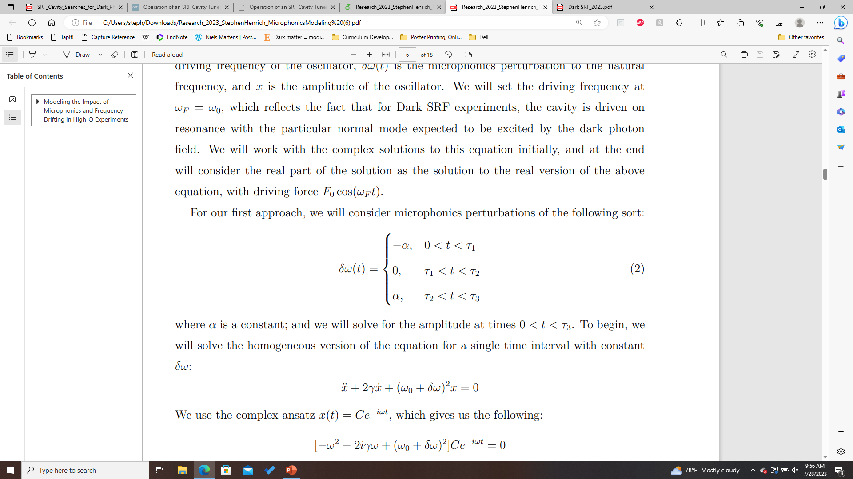
Analytic and Numerical Models
Analytic Model Algorithm:
Analytic Model:
1. Initialize parameters and BCs
2. Generate Jitter
t
3. From initial BCs and jitter, evolve the system using EOMs (left) → obtain new BCs and funcs for the next interval
4. Plot piecewise function, stitching together analytic results for each interval
Numerical Model:
Microphonics

Slide 2
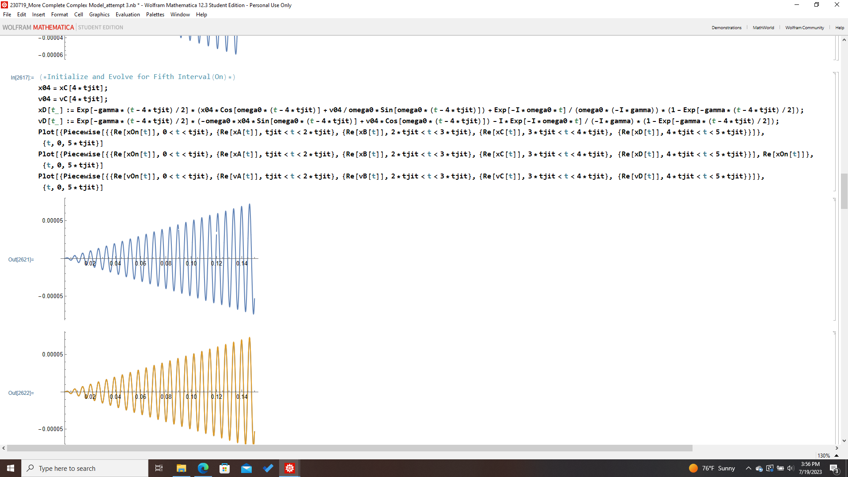
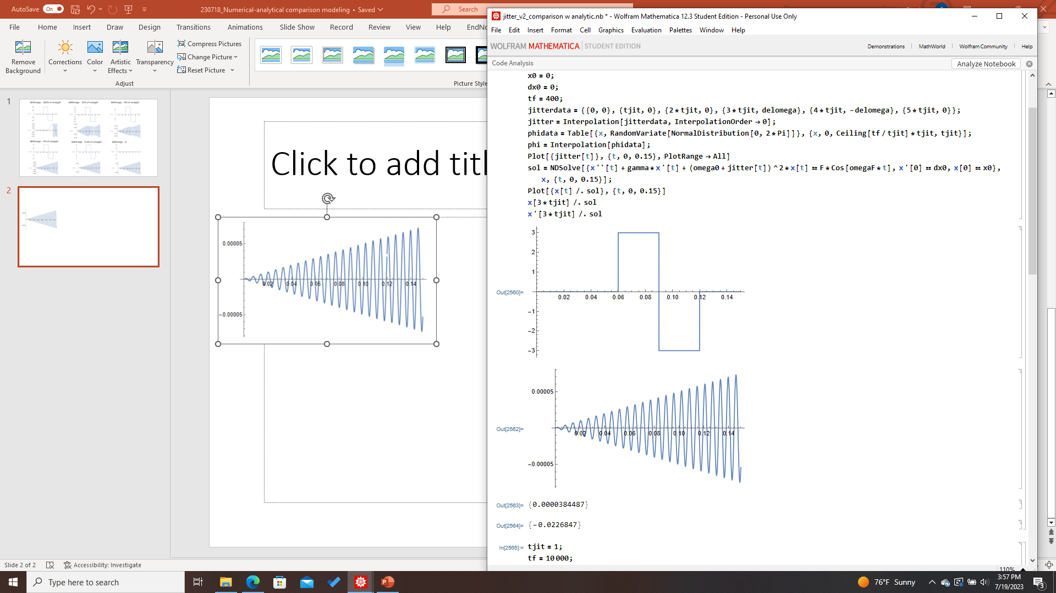
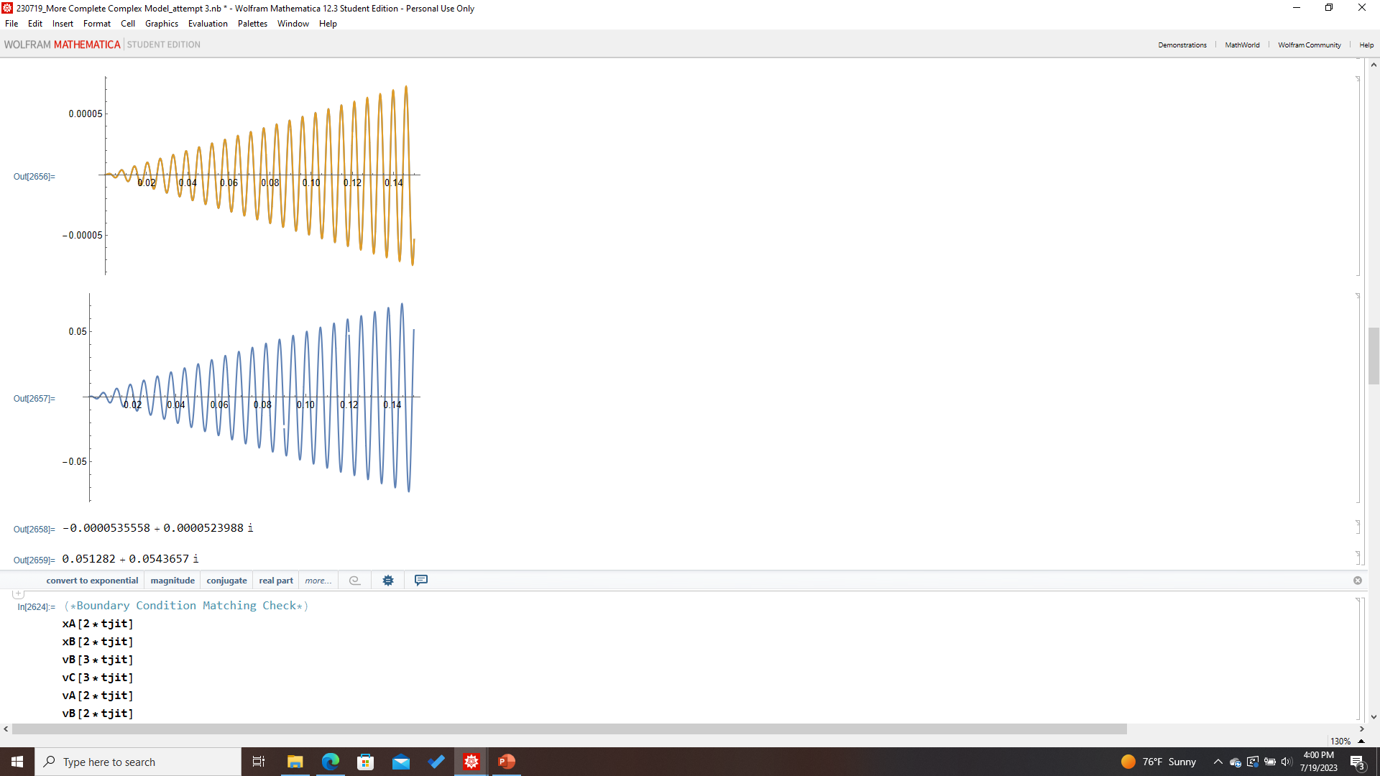
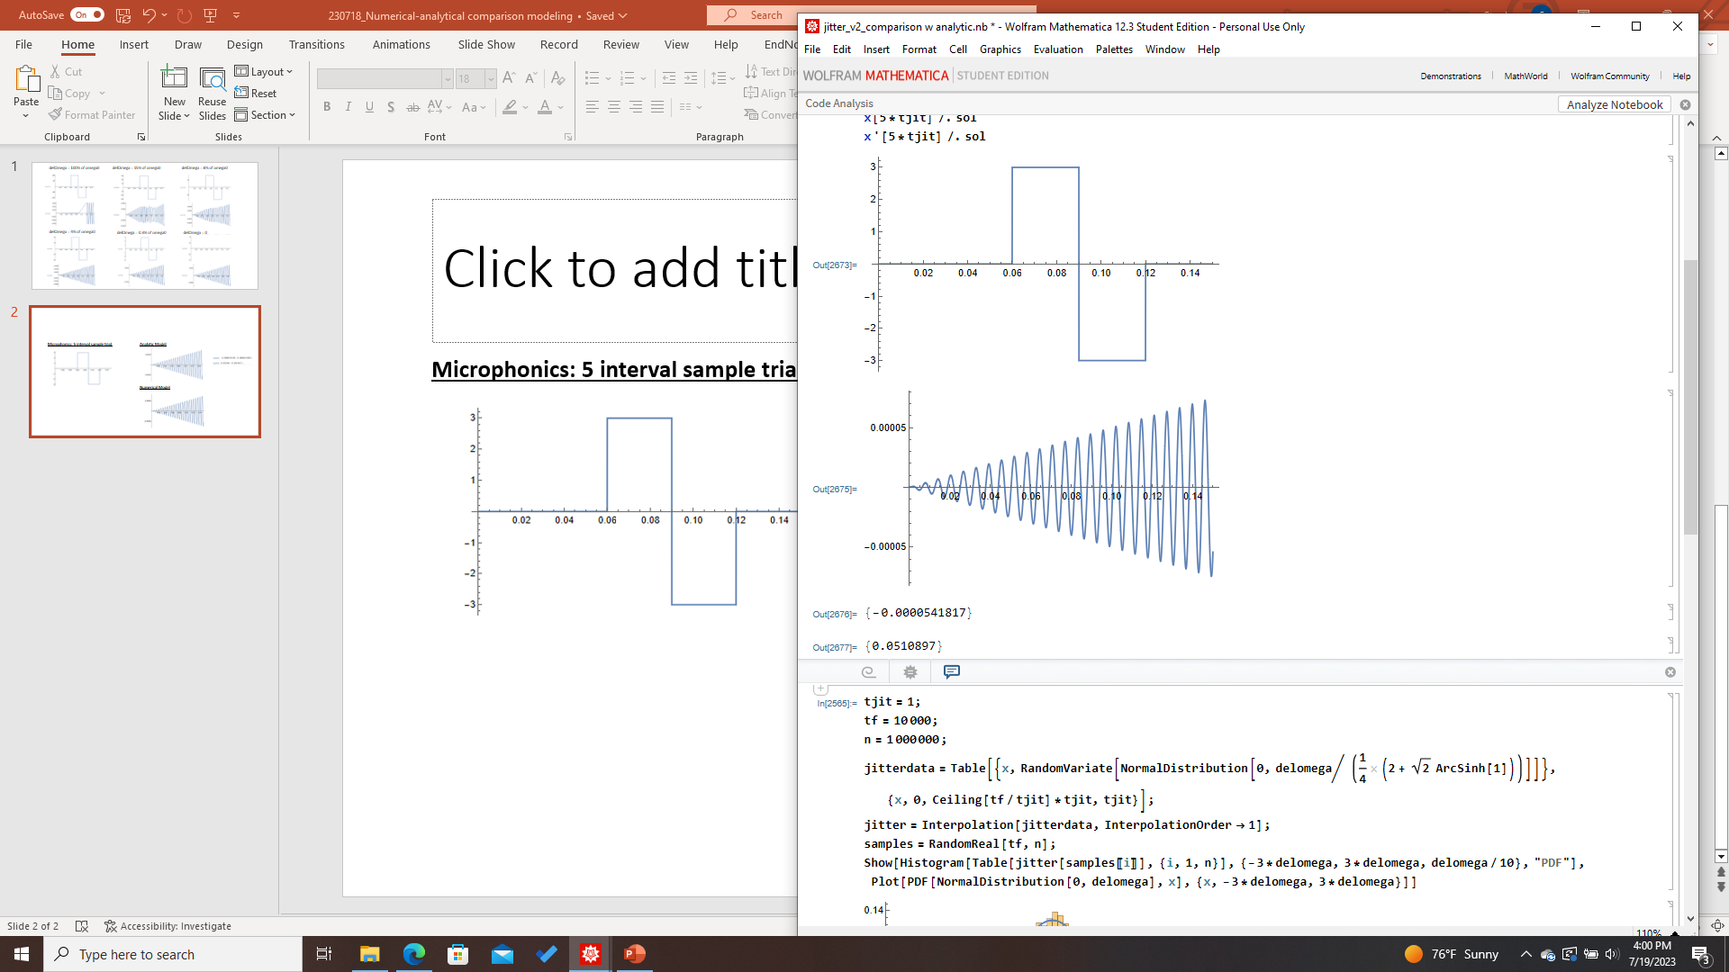
Baseline Analytic/Numerical Comparison
Microphonics: 5 interval sample trial
Analytic Model
Amplitude
Velocity
Numerical Model
1.16% error in amplitude
0.38% error in velocity

Slide 3
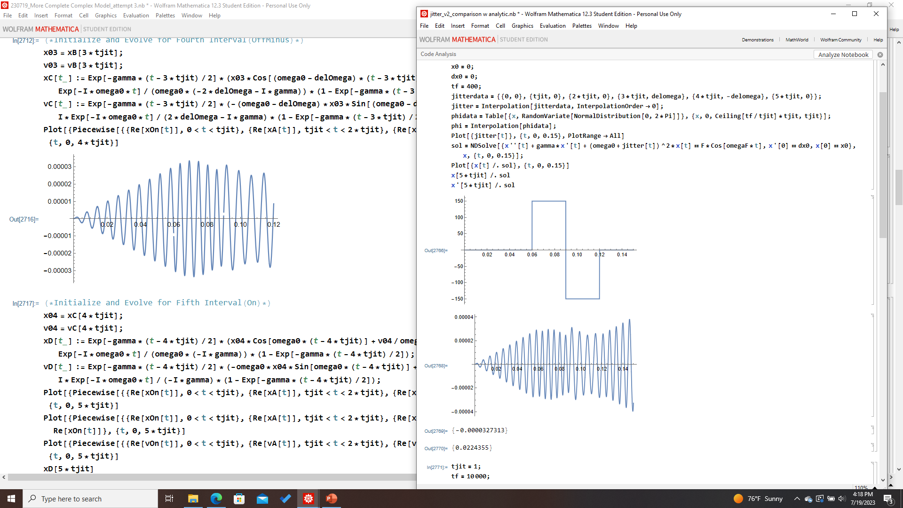
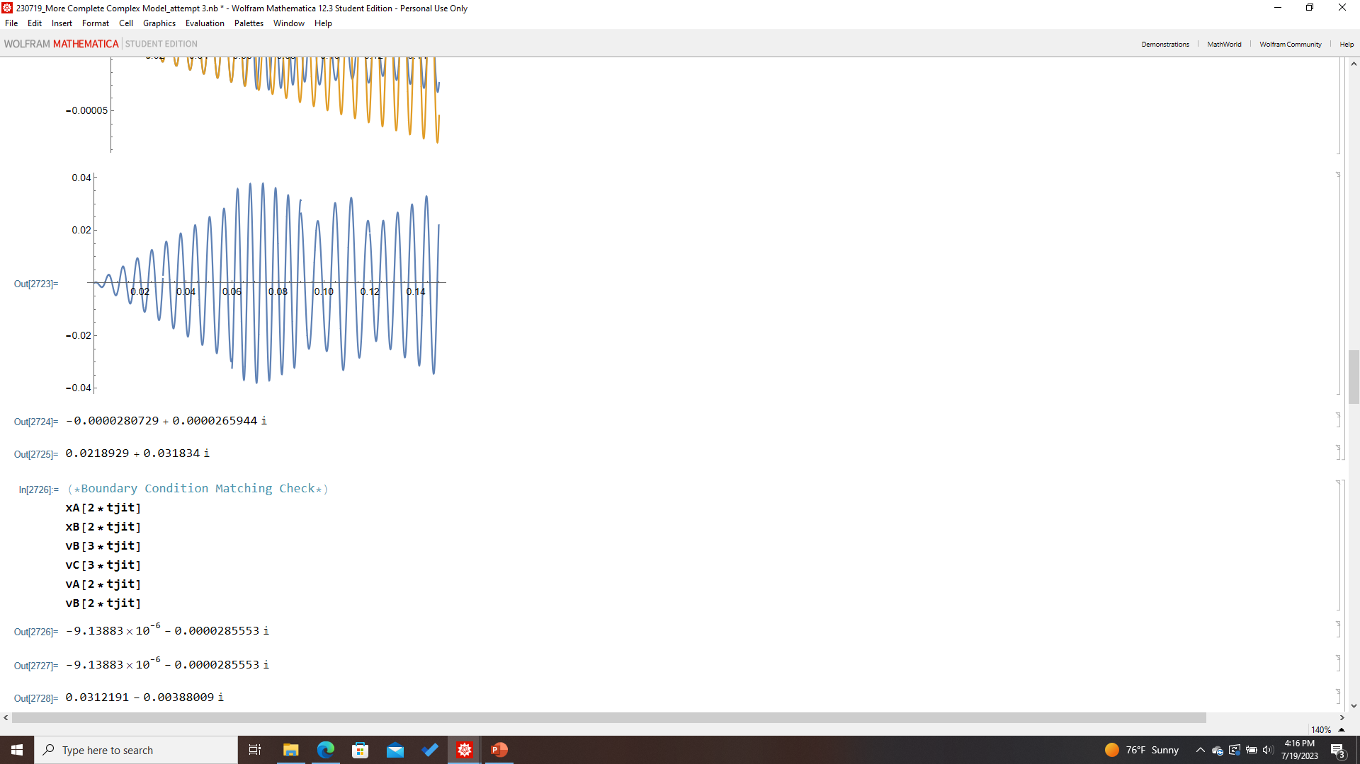
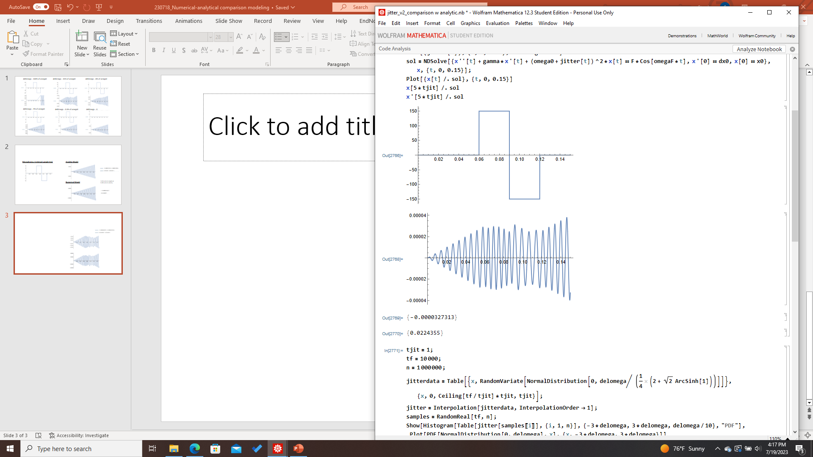
Very High Delta Omega
Microphonics: 5 interval sample trial
Analytic Model
Numerical Model

Slide 4
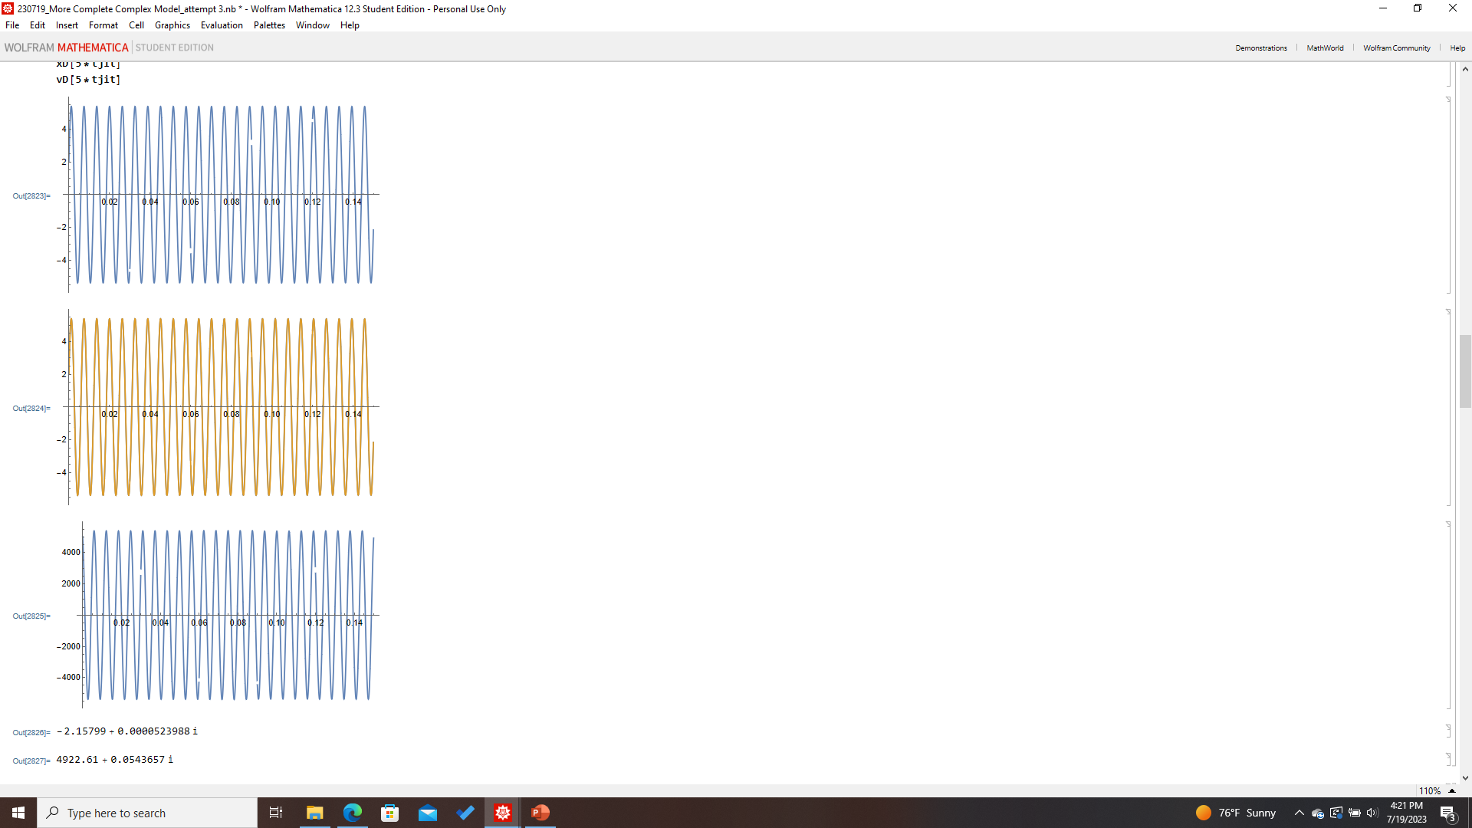
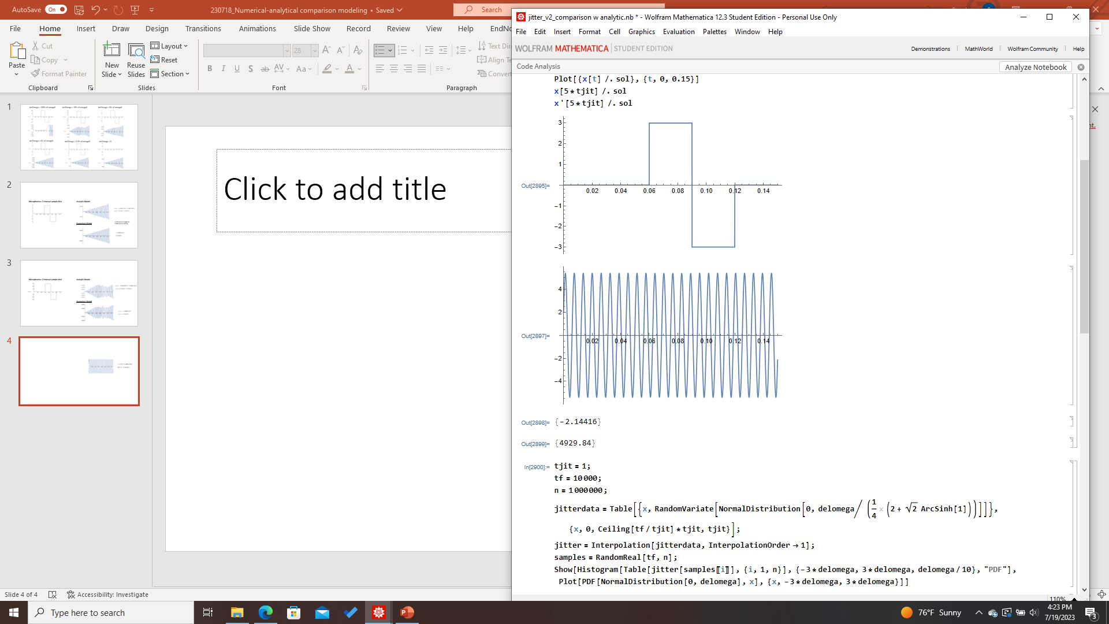
Different Initial Conditions (non-zero amplitude and velocity)
Microphonics: 5 interval sample trial
Analytic Model
Numerical Model

Slide 5
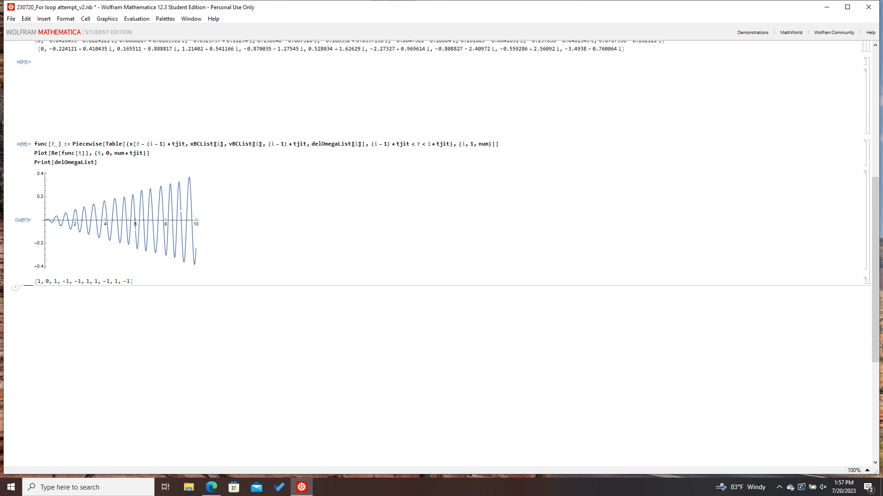
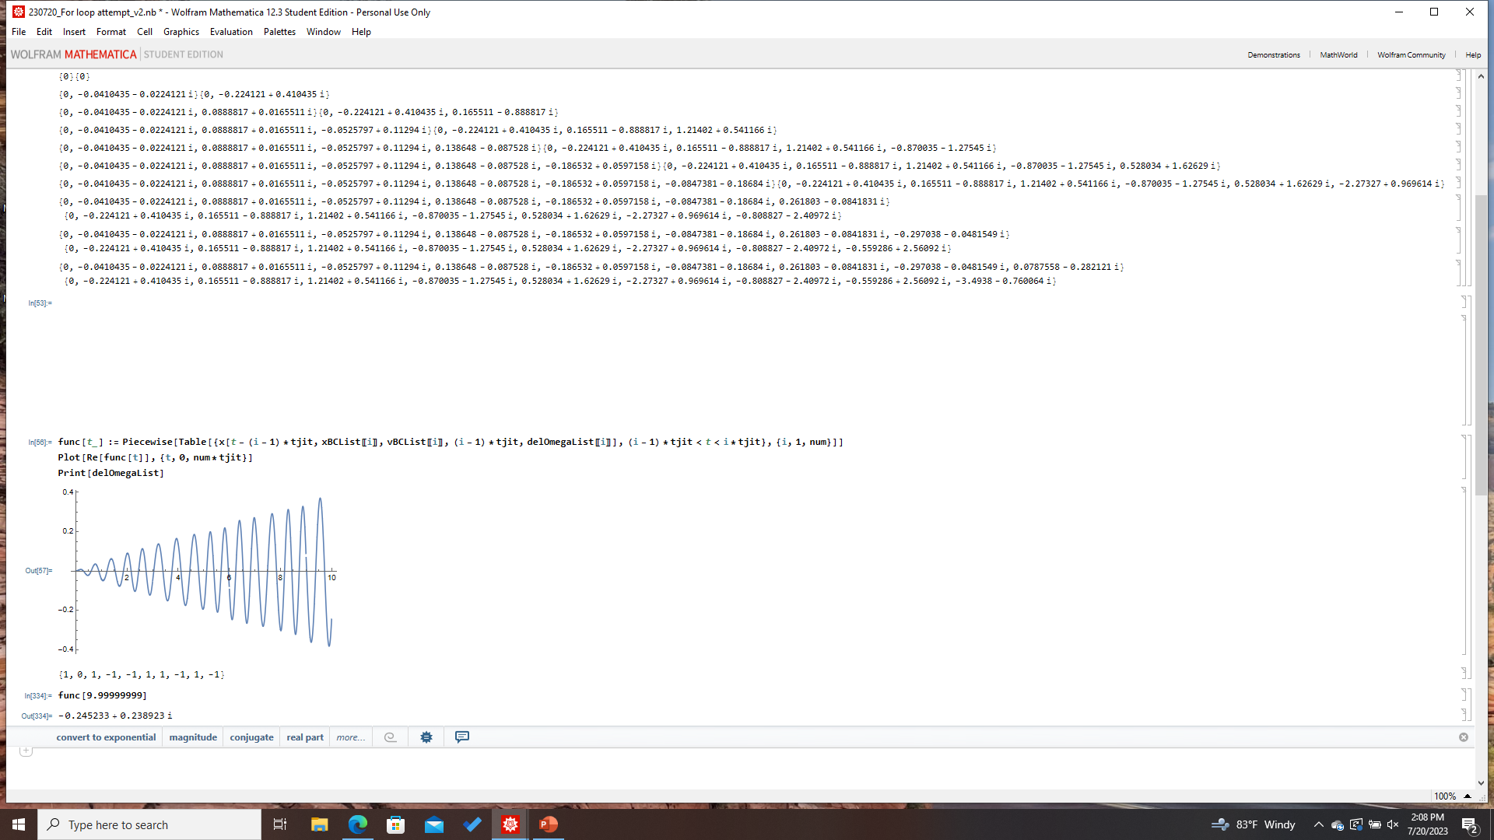
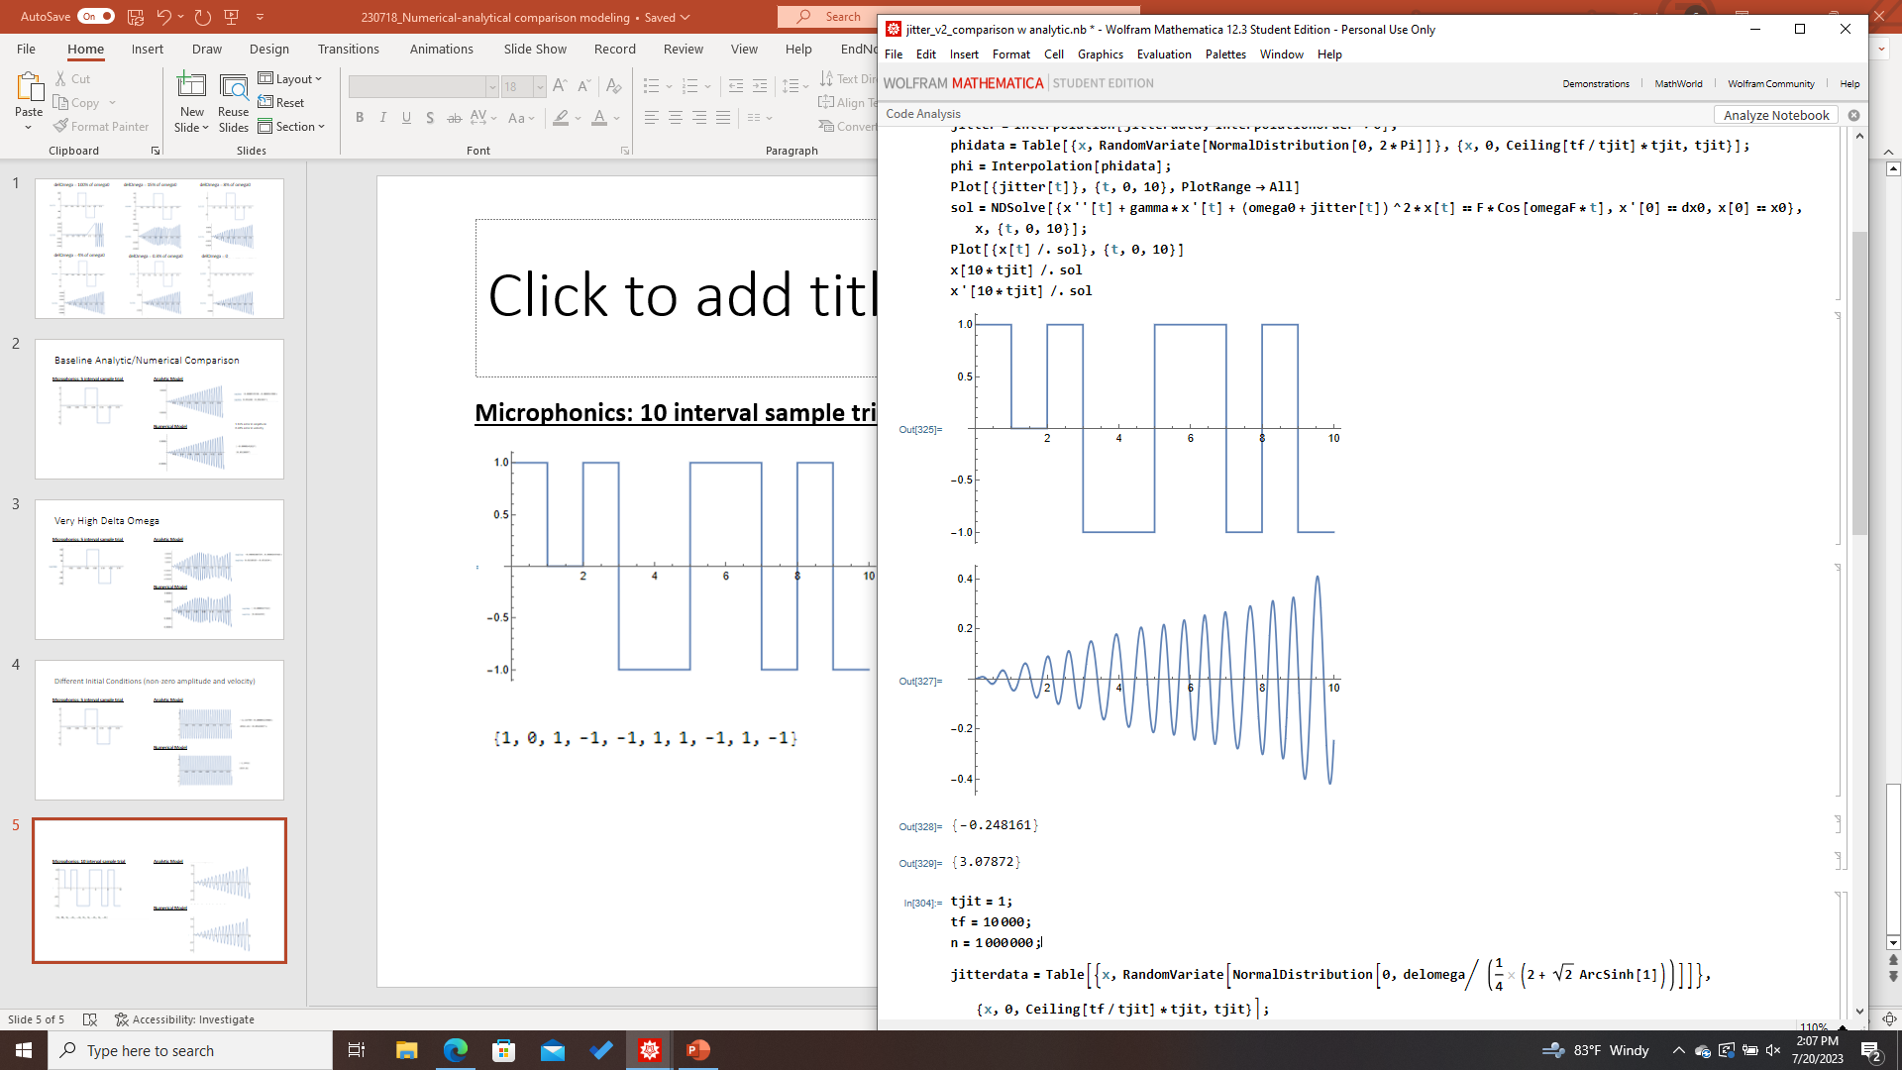
Higher Interval Number
Microphonics: 10 interval sample trial
Analytic Model
Numerical Model

Slide 6
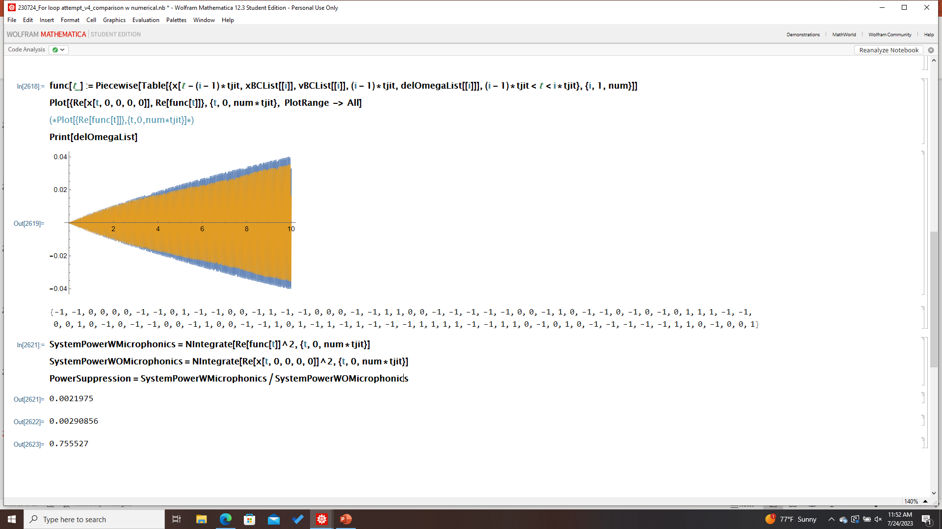
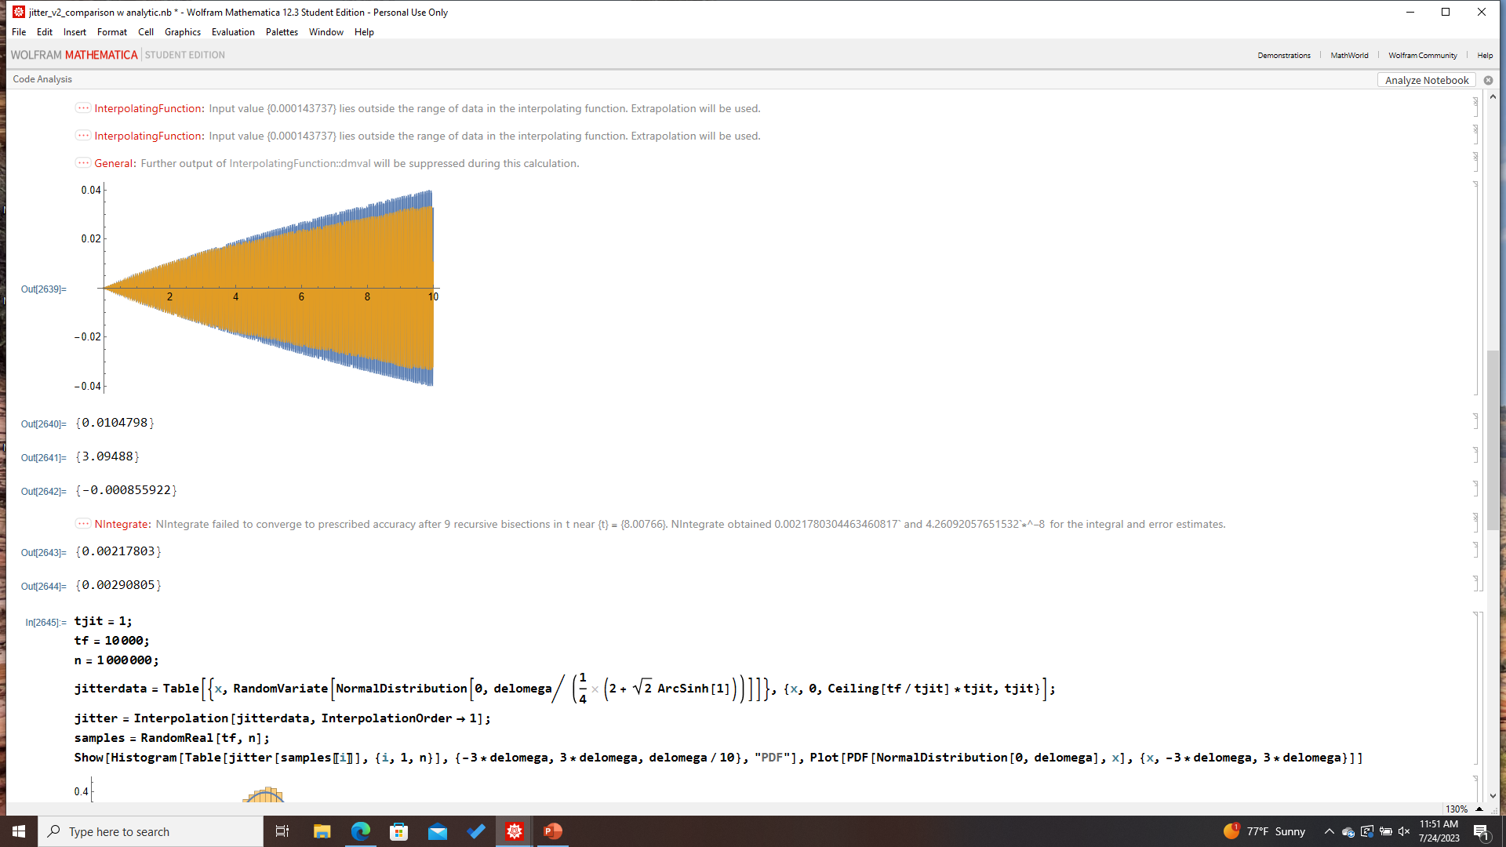
Numerical vs Analytic Comparison
Parameters:
omega0= omegaF=100
gamma=0.1
tjit=0.1
delOmega=1
Time: 10 s
# of intervals: 100
Analytic
Power Results
w/o microphonics
0.00290856
w/ microphonics
0.0021975
Suppression factor:
0.755527
Numerical
Power Results
w/o microphonics
0.00290805
w/ microphonics
0.00217803
Suppression factor:
0.748966
Percent error: 0.868%

Slide 7
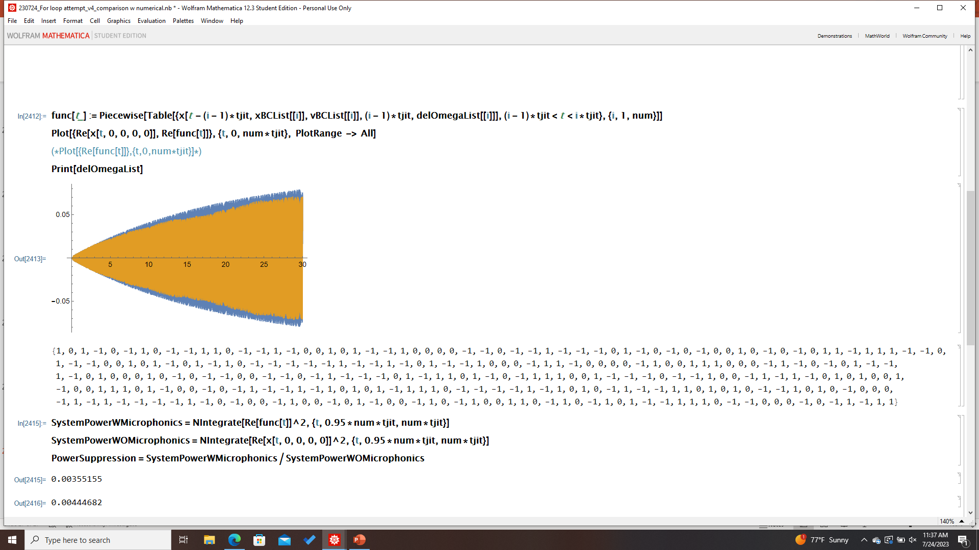
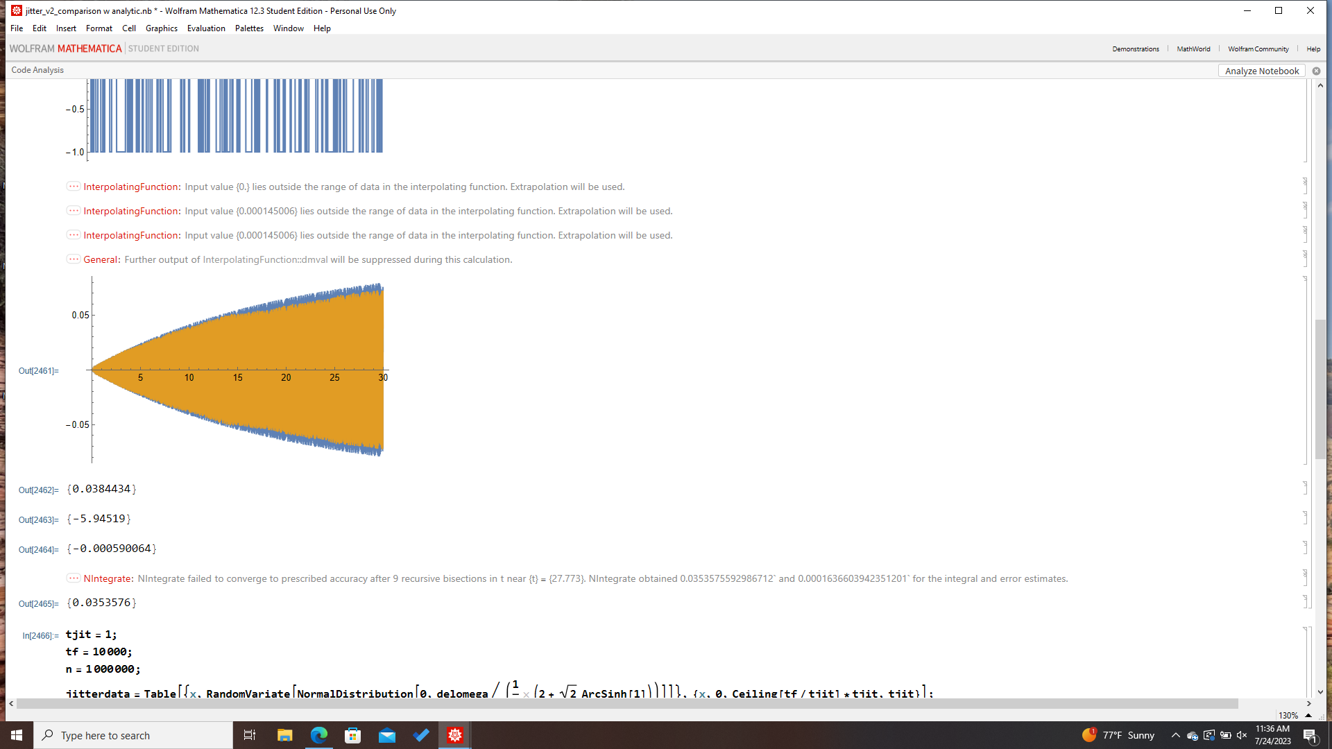
Numerical vs Analytic Model Comparison
Analytic
Parameters:
omega0= omegaF=100
gamma=0.1
tjit=0.1
delOmega=1
Time: 30 s
# of intervals: 300
Numerical
Power percent error: 0.4%

Slide 8
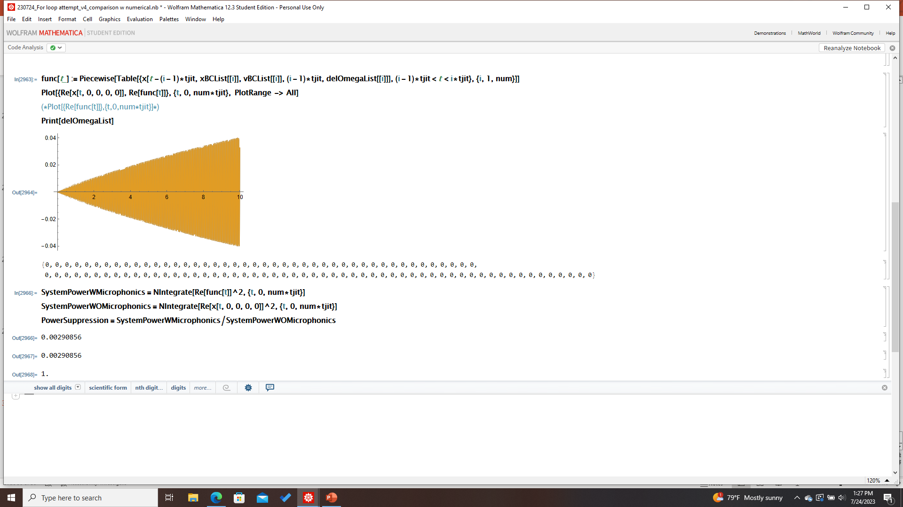
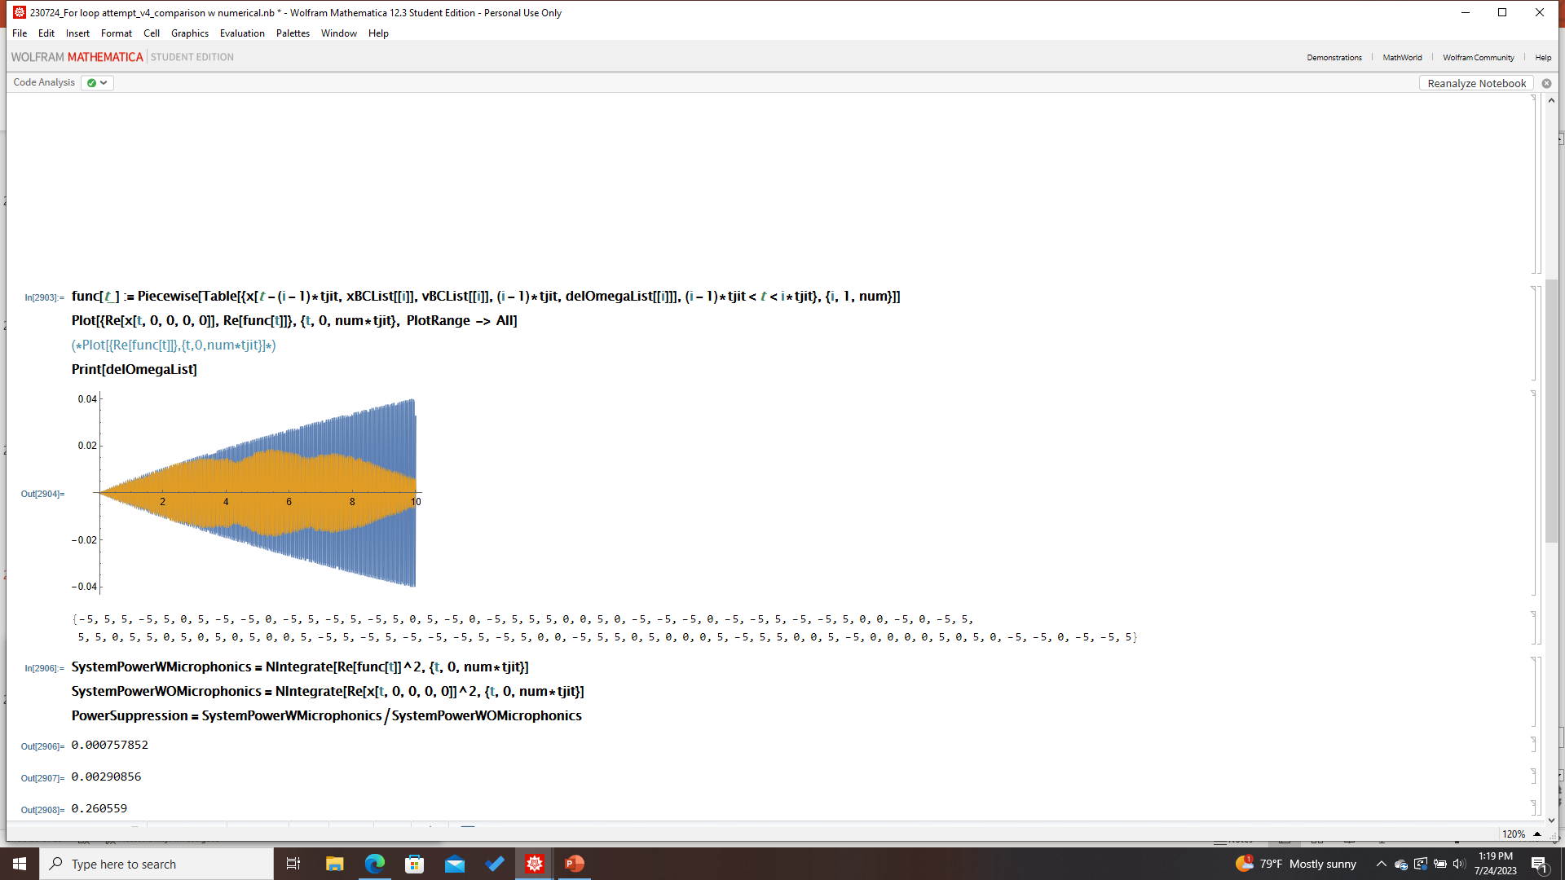
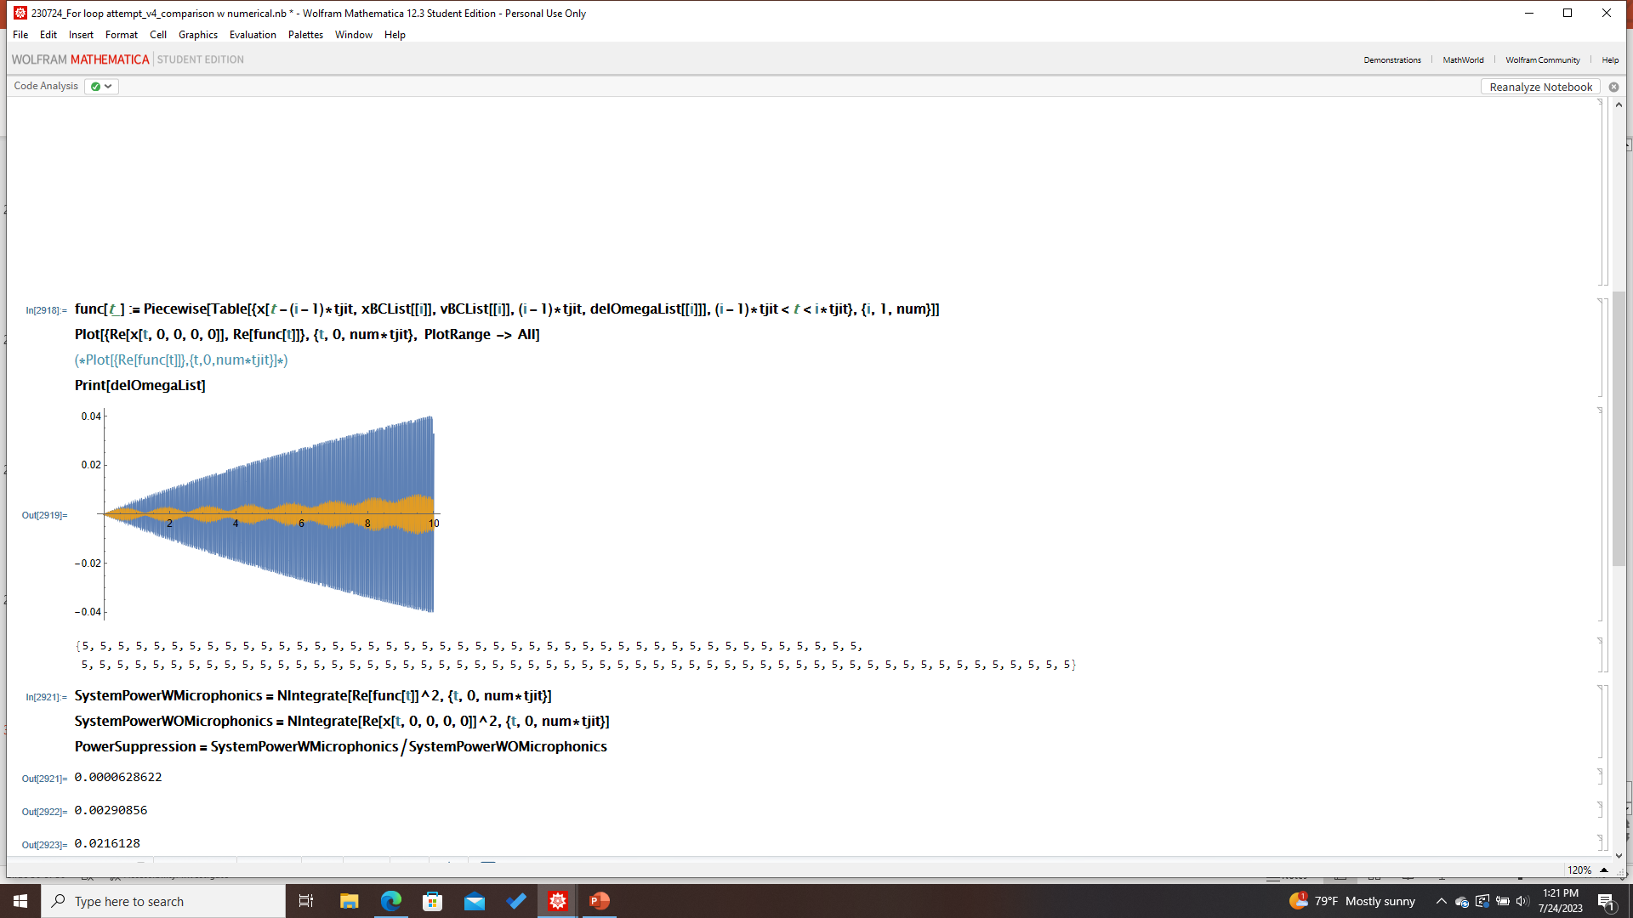
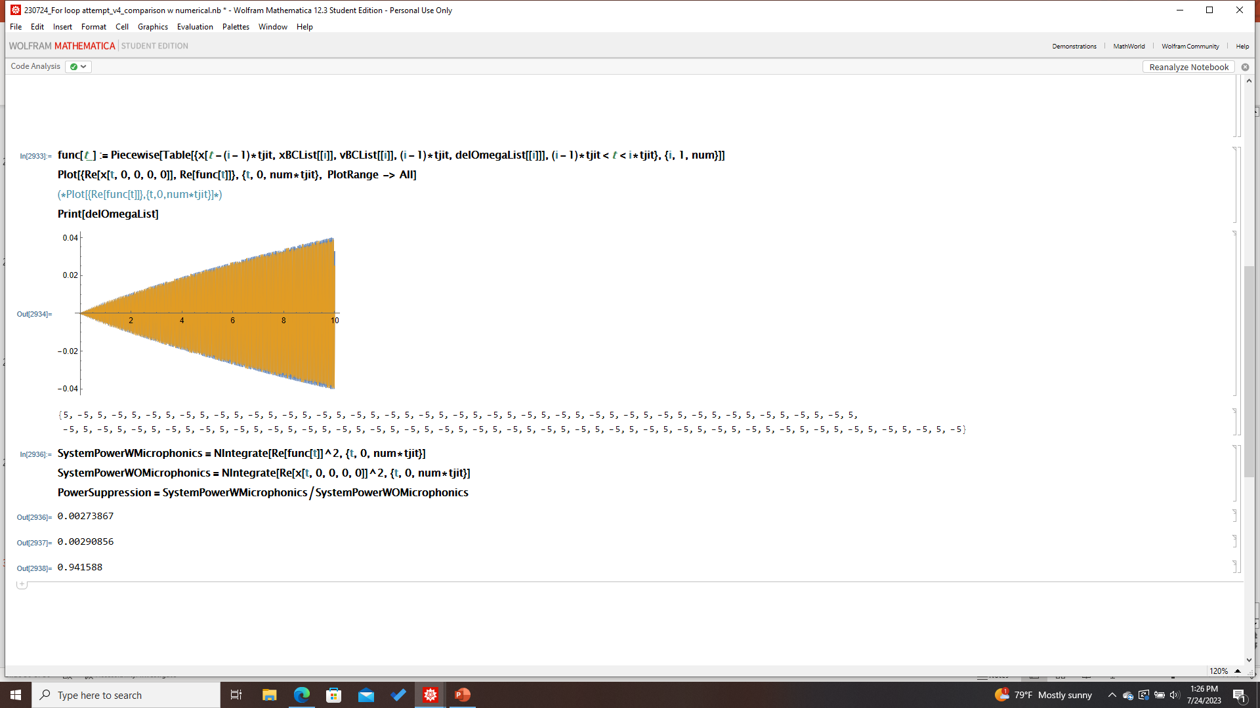
Analytic Model: Testing Microphonics Patterns
Parameters:
omega0= omegaF=100
gamma=0.1
tjit=0.1
delOmega=5
Time: 10 s
# of intervals: 100
Microphonics: None
Microphonics: Random 3-choice jitter
Microphonics: Fixed Offset
Microphonics: Pure alternating
!!

Slide 9
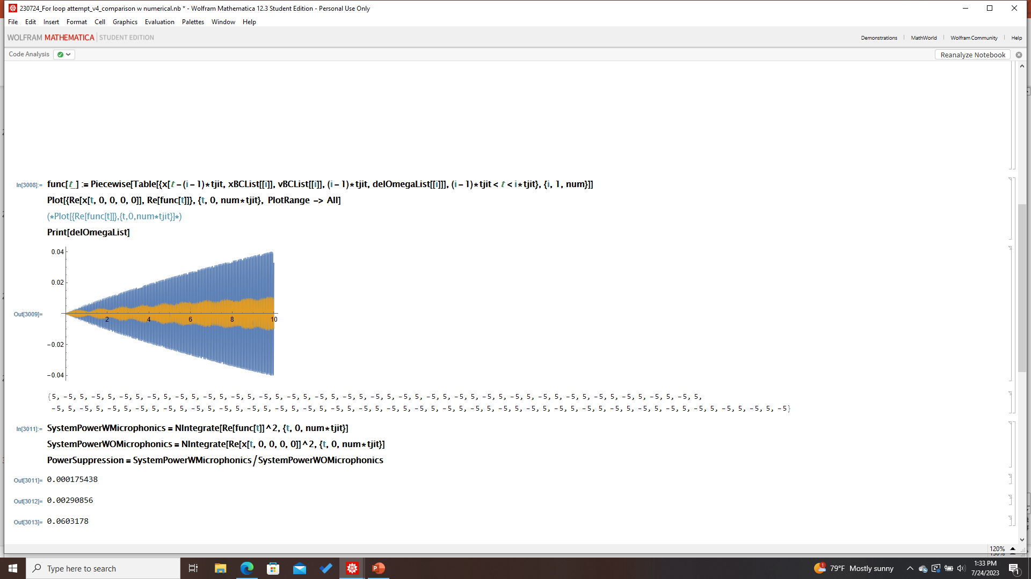
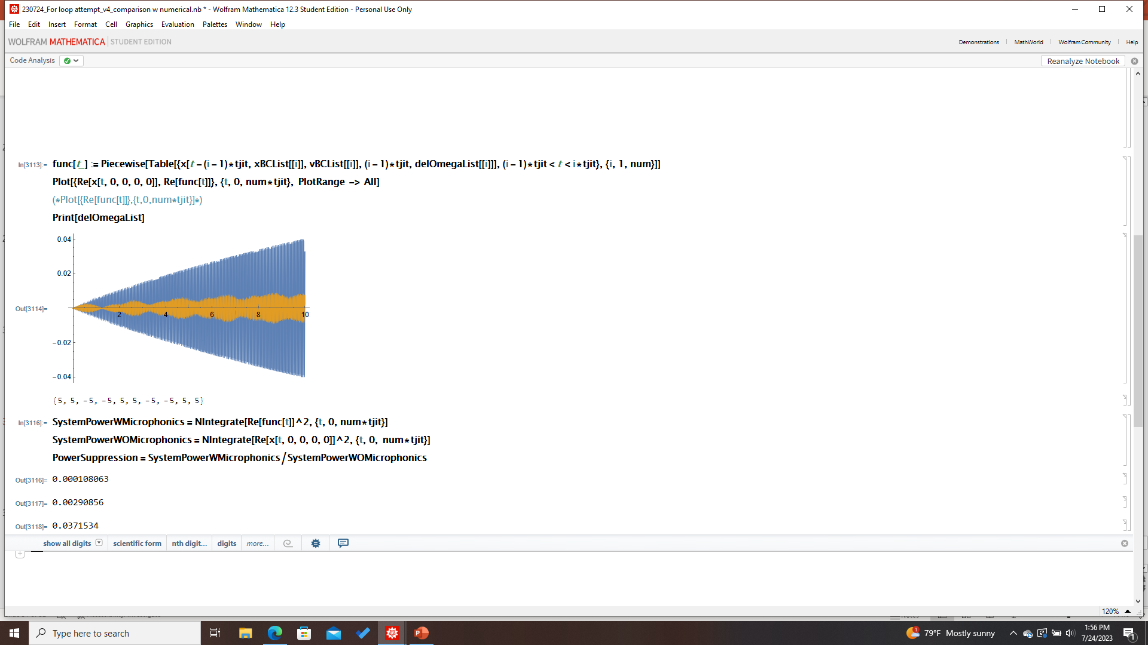
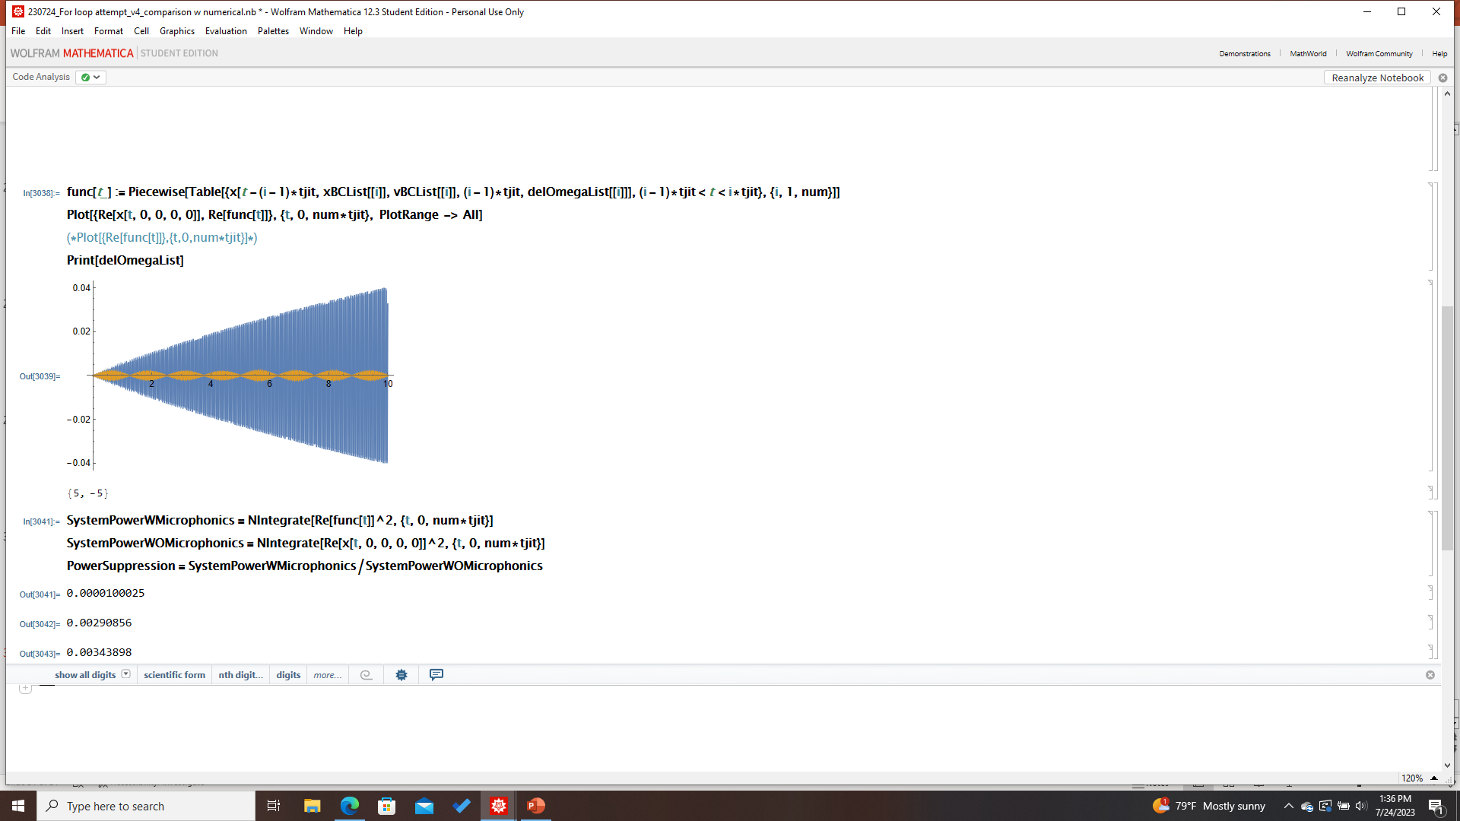
A Closer Look at Pure Alternating Systems (tjit dependence)
Tjit=0.1 (100 intervals)
Tjit=1 (10 intervals)
Tjit=0.25 (4 intervals)
Power Suppression: 0.9416
Power Suppression: 0.0603
Power Suppression: 0.03715
Tjit=5 (2 intervals)
Percentage of Time Off-Resonance: 100% for all four of these trials
Follow-up: decreasing tjit → asymptotes to 100% power retention
Power accumulation is maximal when tjit ~ gamma
Could tune the cavity temperature to make tjit as close to gamma as possible
Power Suppression: 0.003439

Slide 10
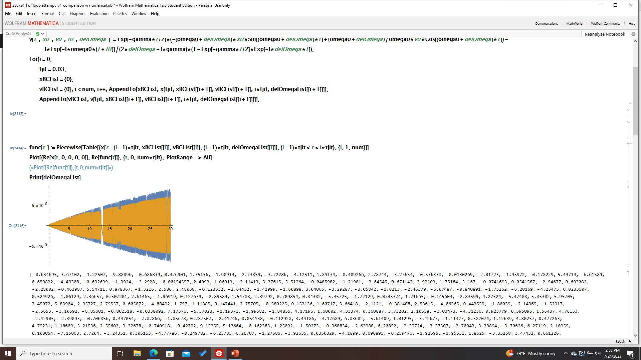
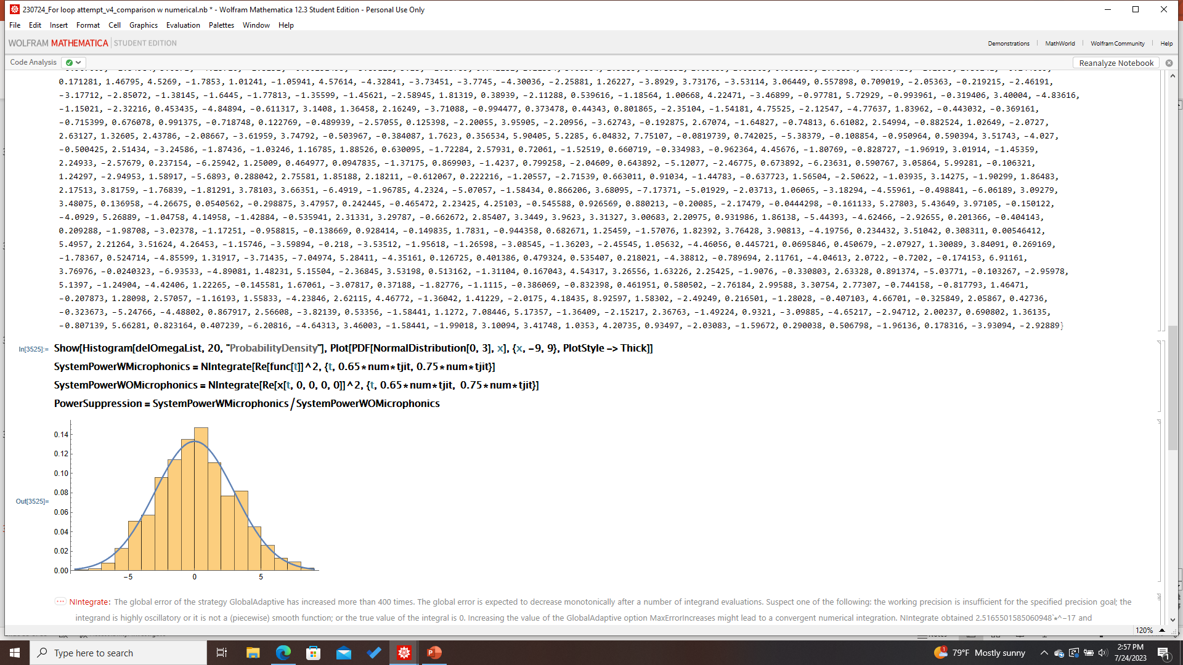
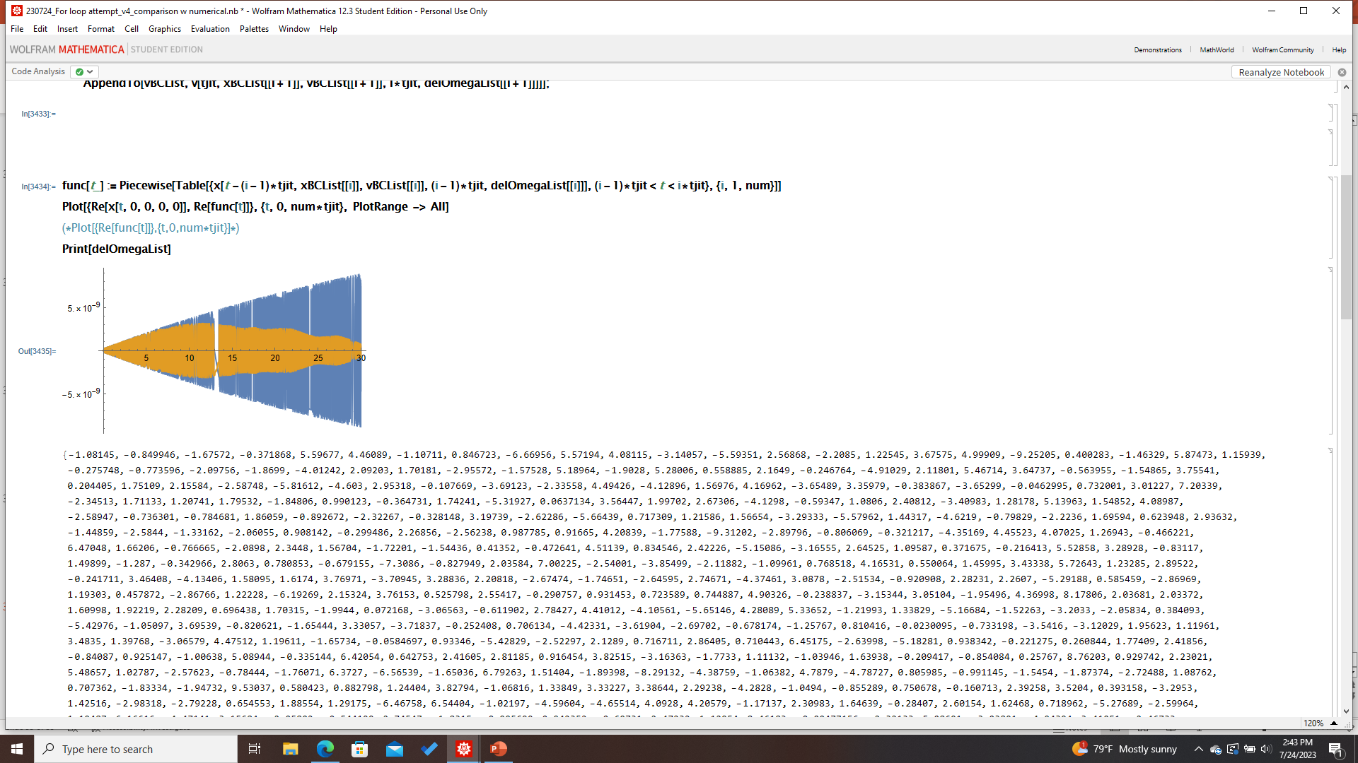
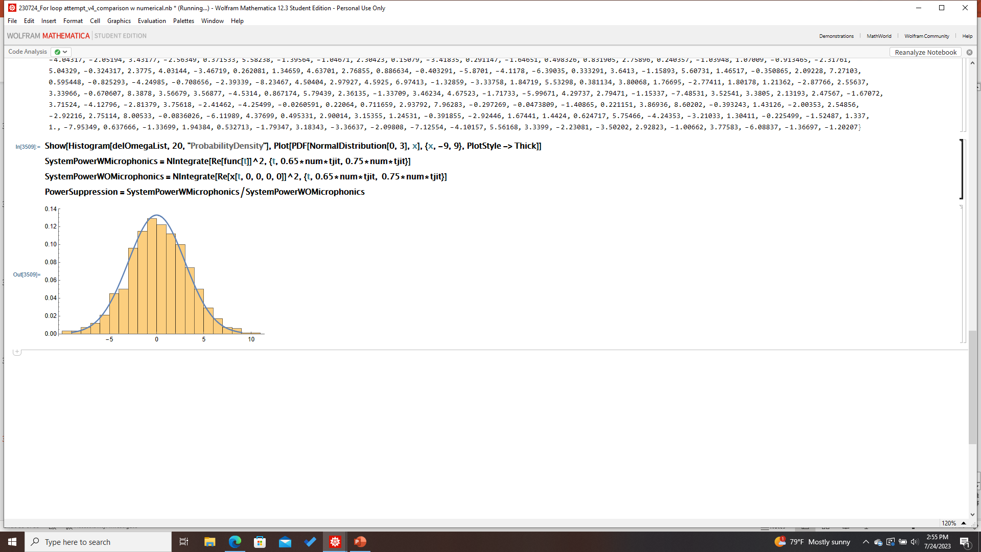
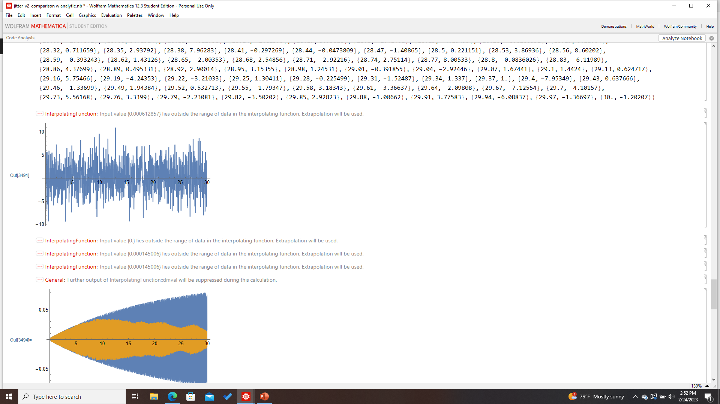
Analytic, Physical Model
Trial A
Jitter Distribution
Parameters:
omega0= omegaF=1.3 GHz
gamma=0.04
tjit=0.03
delOmega=3 Hz
Time: 30 s
# of intervals: 1000
Note: numerical model cannot accommodate such high omega0
Power Suppression: ~0.6224
Microphonics: RandomVariate[NormalDist[0,3]]
Trial B
Power Suppression: ~0.1208

Slide 11
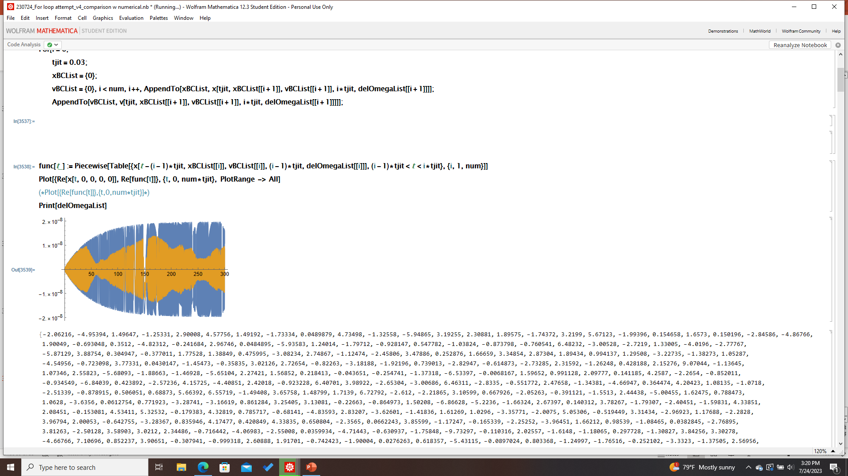
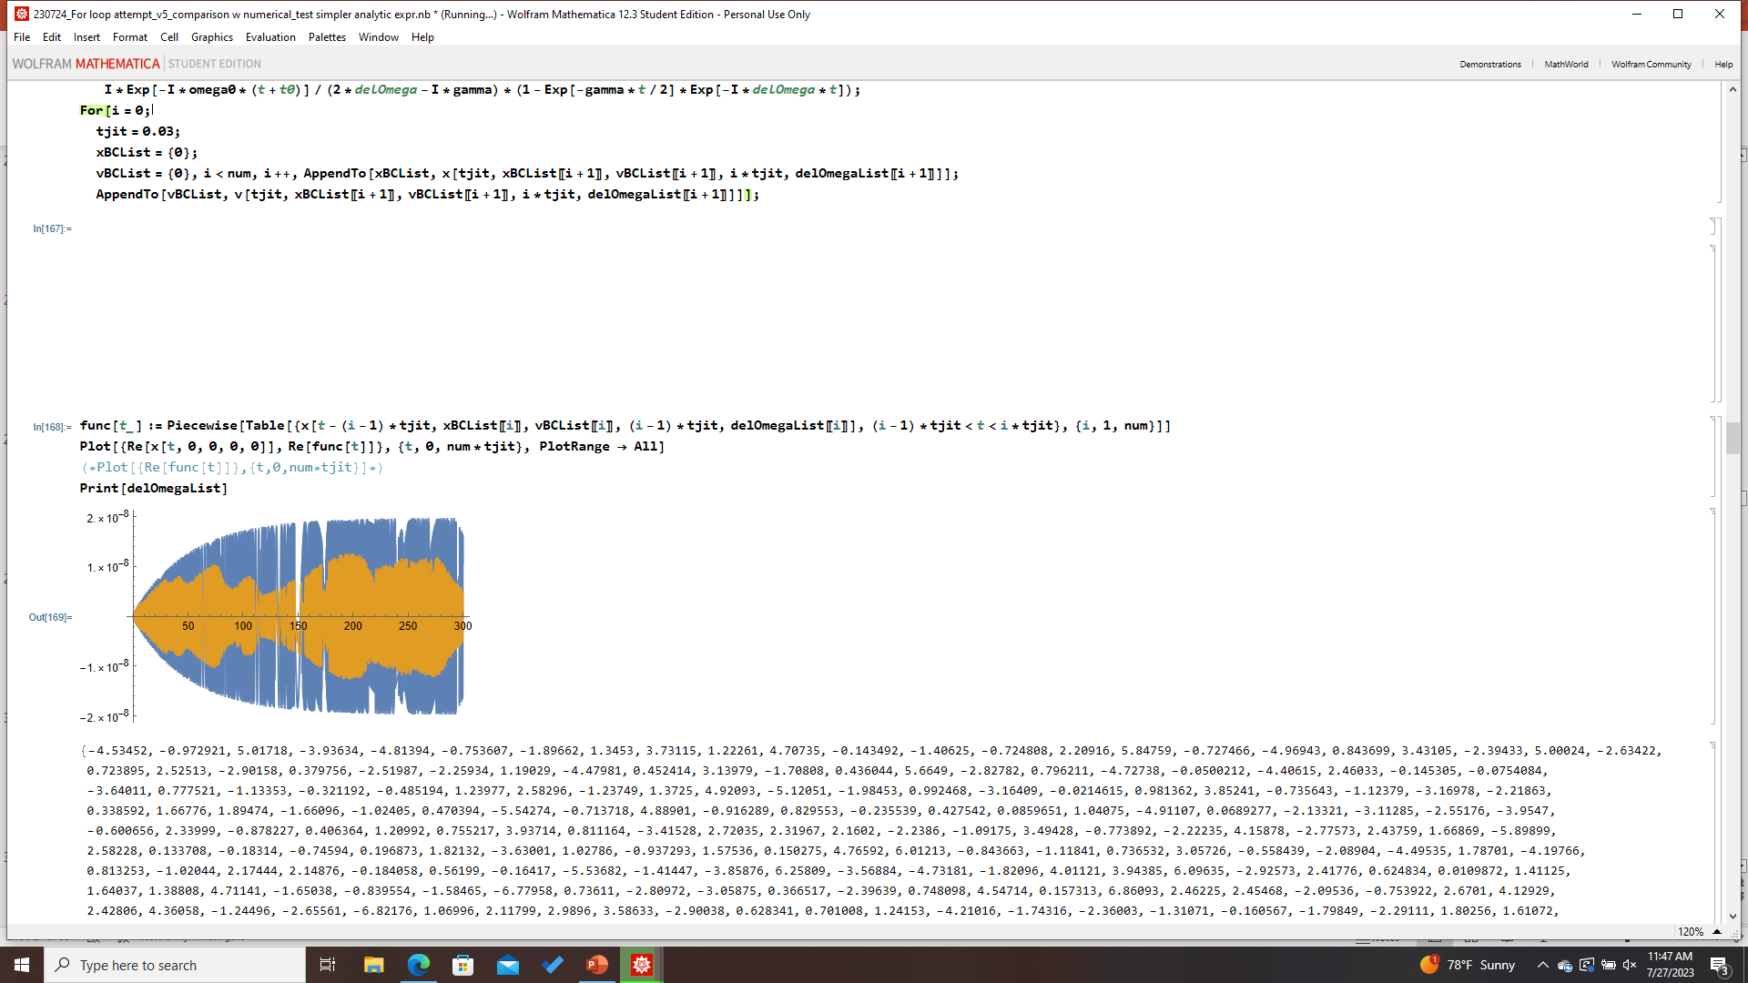
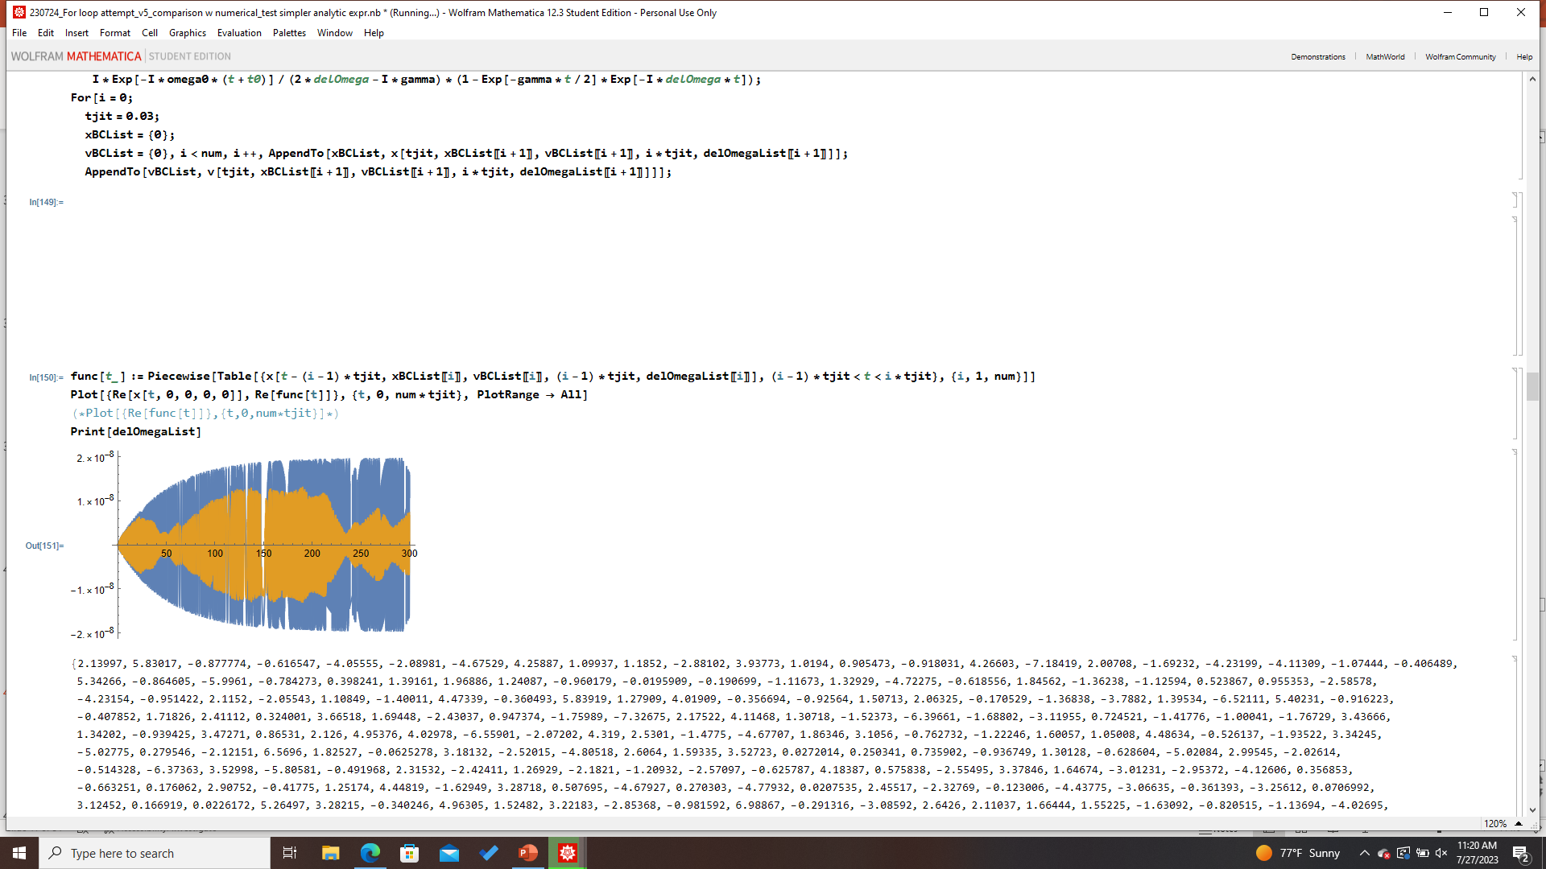
Analytic, Physical Model (5 min trial)
Parameters:
omega0= omegaF=1.3 GHz
gamma=0.04
tjit=0.03
delOmega=3 Hz
Time: 5 min (300 s)
# of intervals: 10000
Microphonics: Rand[NormDist[0,3]]
Trial A
Trial C
Estimated Power Suppression: 0.1-0.2
Trial B

Slide 12
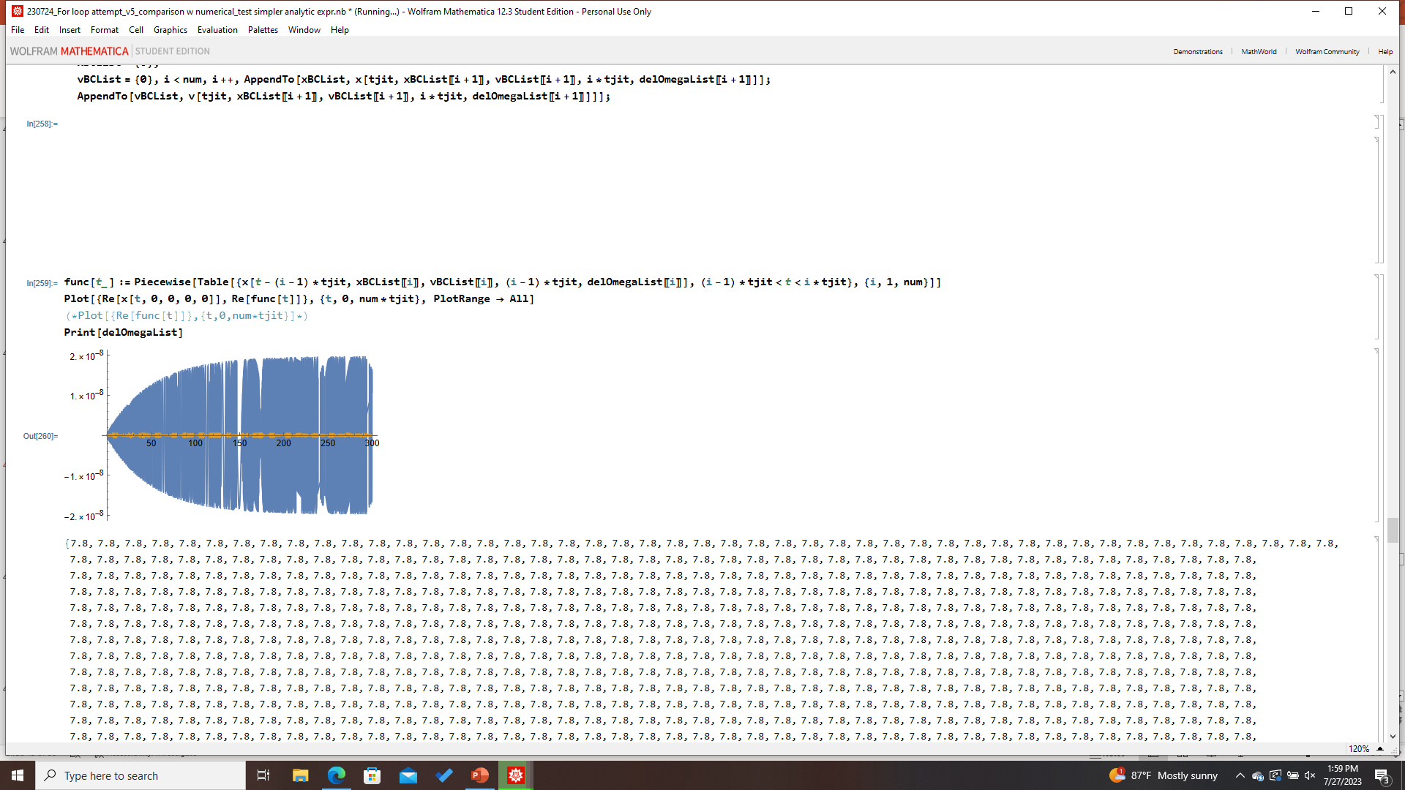
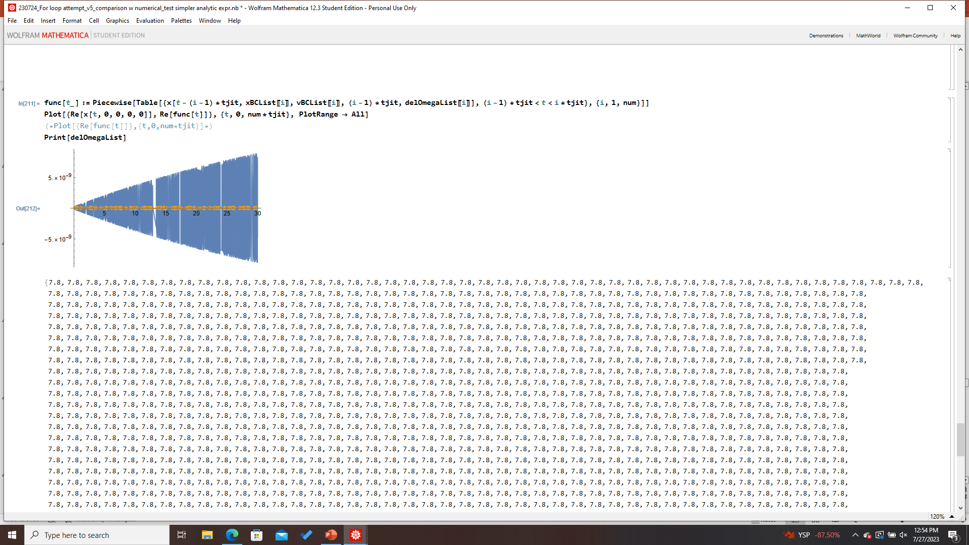
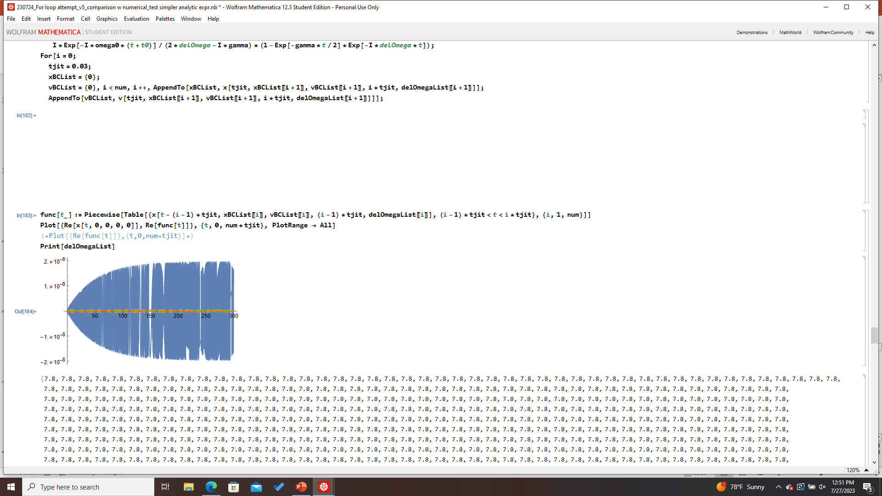
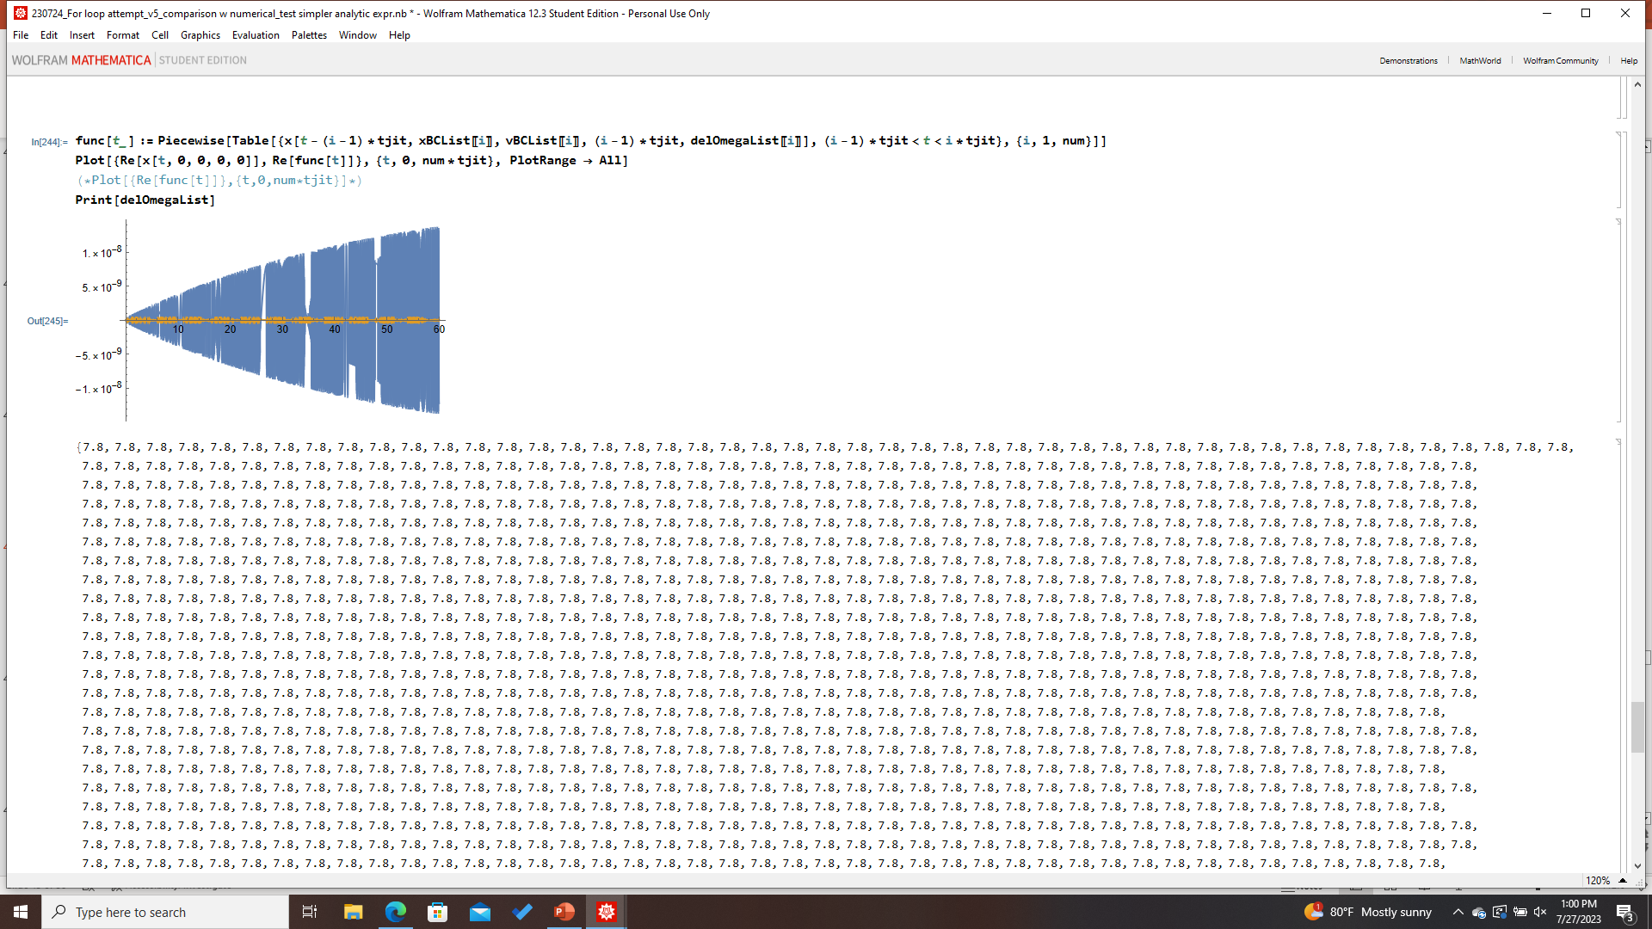
Analytic, Physical Model (Fixed Offset)
Parameters:
omega0= omegaF=1.3 GHz
gamma=0.04
tjit=0.03
delOmega=7.8 Hz
Time: 5 min (300 s)
# of intervals: 10000
Microphonics: Fixed offset, 7.8 Hz
Trial A (5 min)
Trial C (30 s)
Power Suppression: 4.4 x 10⁻⁵
Trial B (5 min)
Trial D (1 min)
Validation Check: fixed offset vs random jitter
Power Suppression: 1.47 x 10⁻⁵

Slide 13
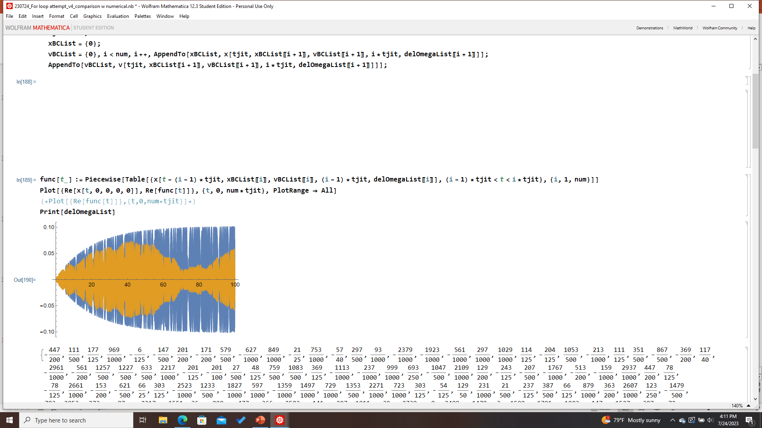
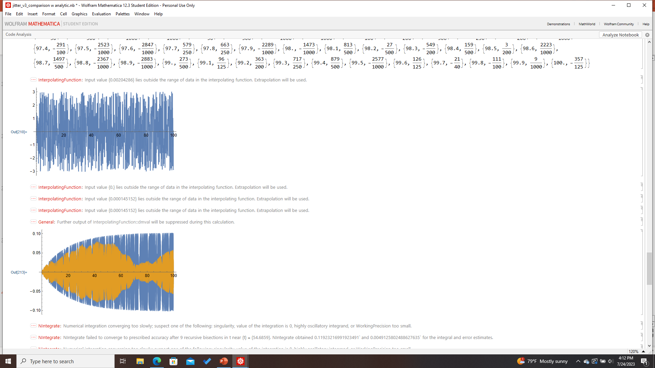
Analytic vs. Numerical Comparison
Parameters:
omega0= omegaF=100
gamma=0.1
tjit=0.1
delOmega=3
Microphonics: RandomChoice[-3,3,0.003]
Time: 100 s (1.66 min)
# of intervals: 1000
Analytic
Numerical

Slide 14
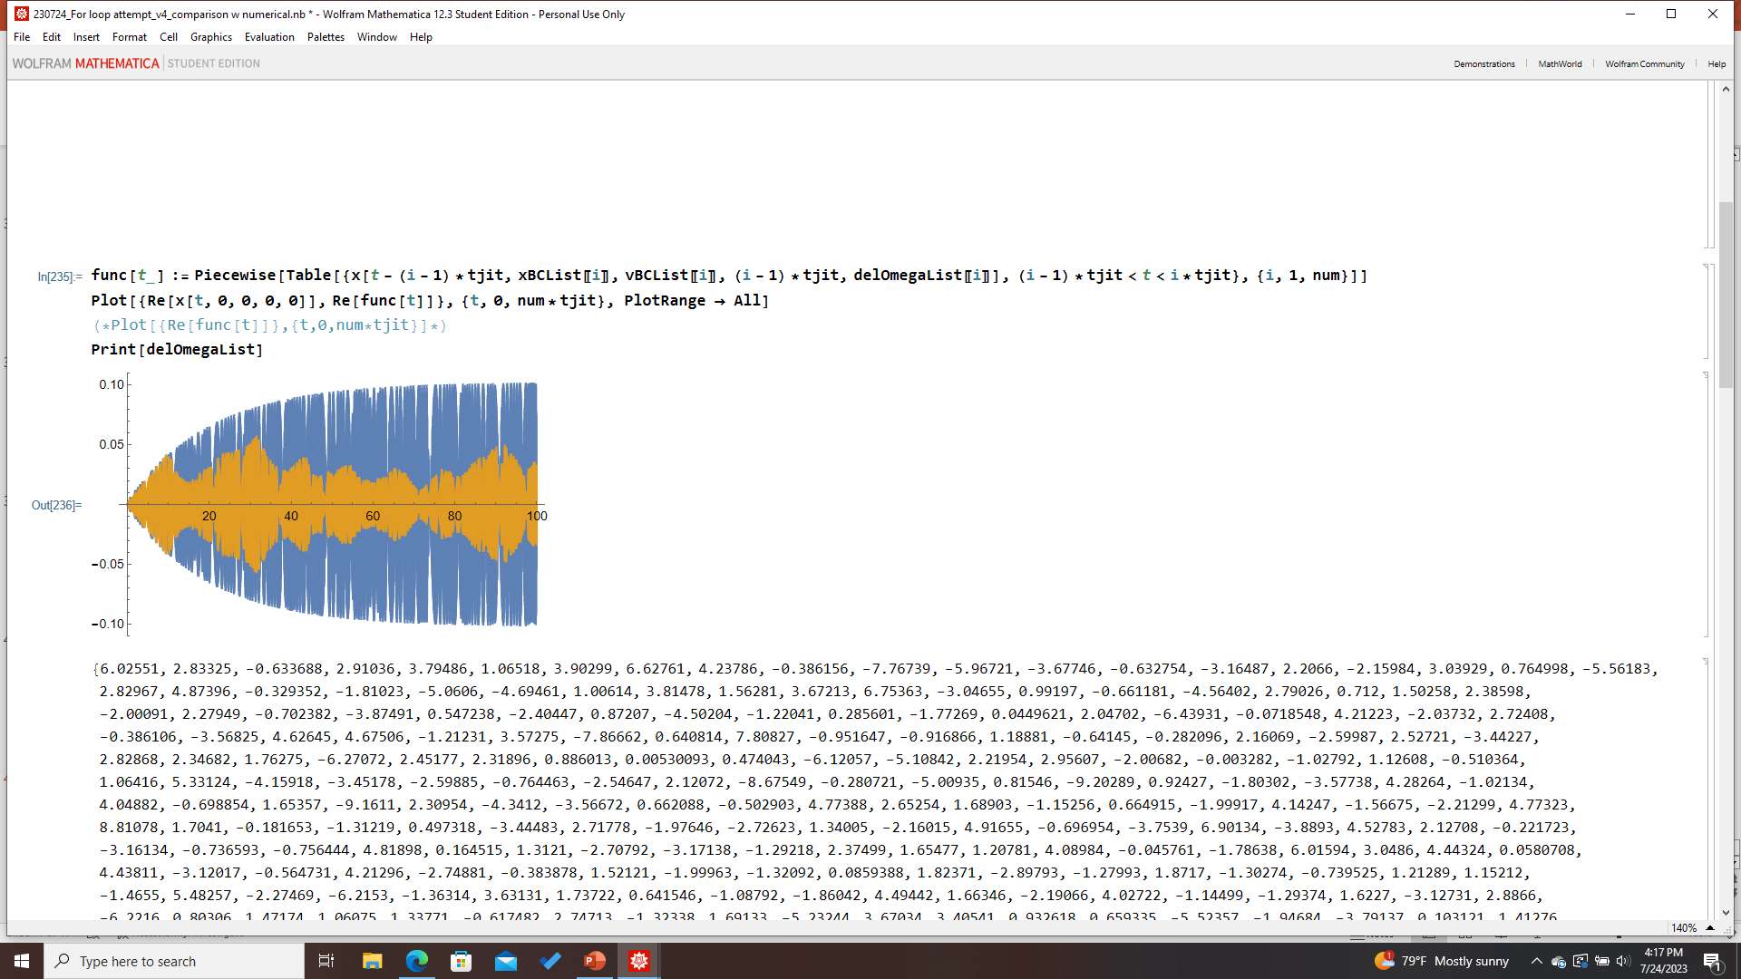
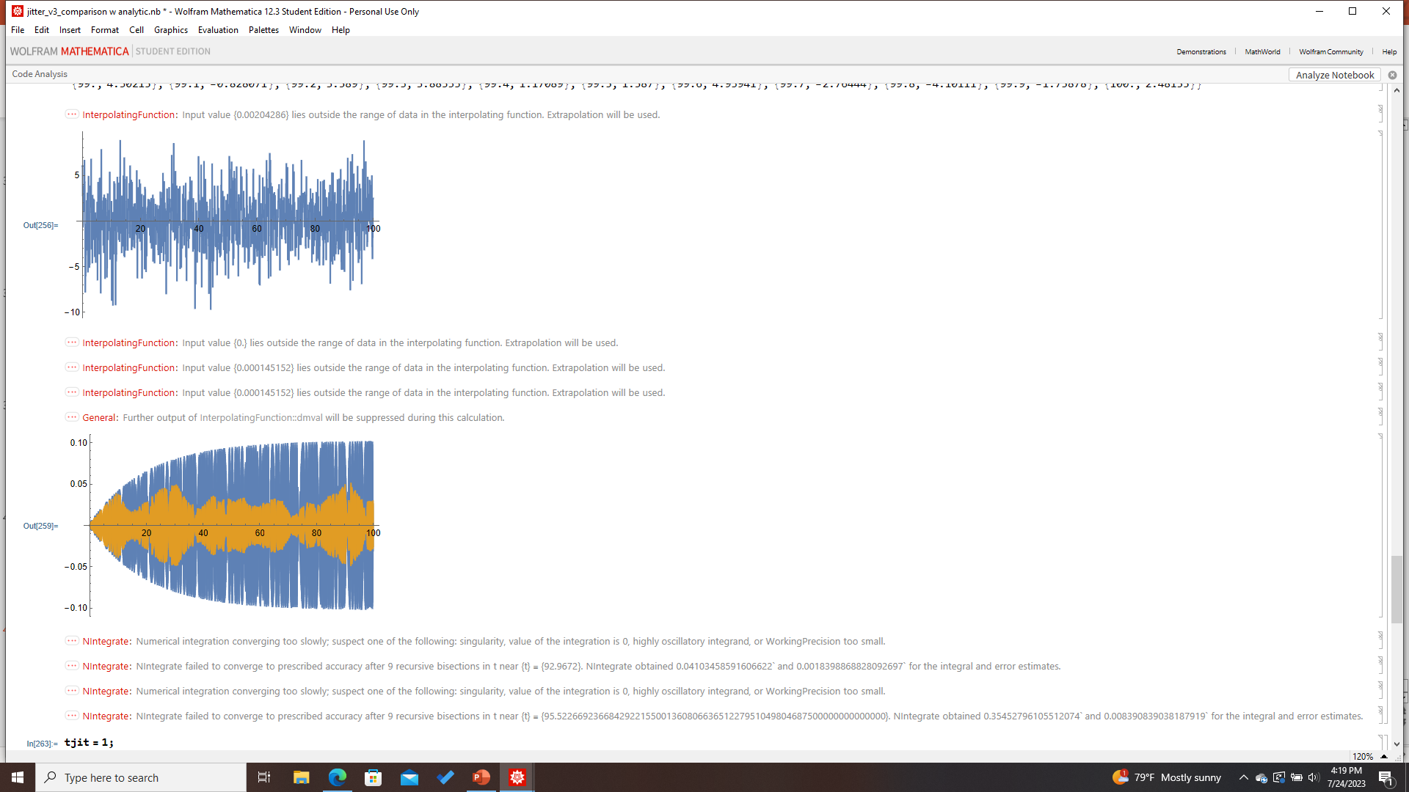
Analytic vs. Numerical Comparison
Parameters:
omega0= omegaF=100
gamma=0.1
tjit=0.1
delOmega=3
Microphonics: RandomVariate[NormDist[0,3],num]
Time: 100 s (1.66 min)
# of intervals: 1000
Analytic
Numerical

Slide 15
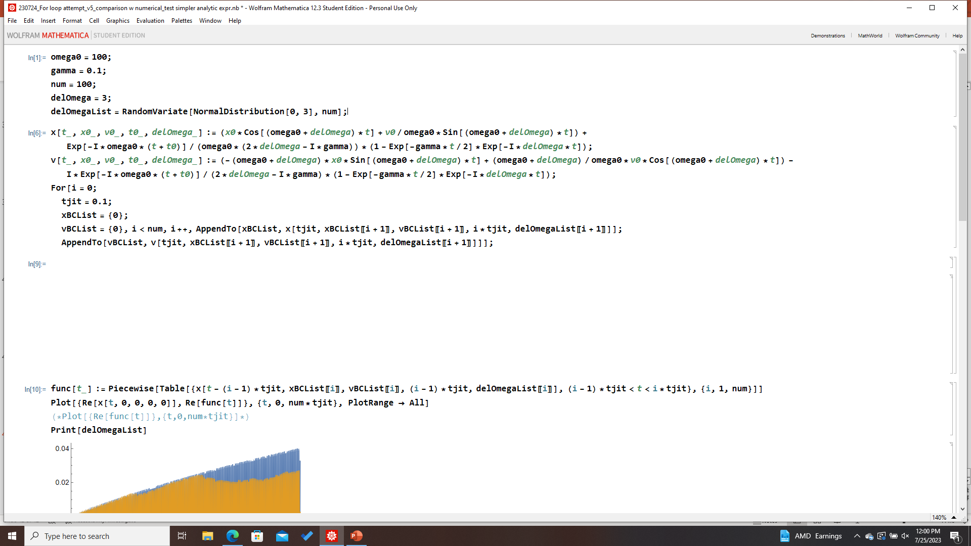
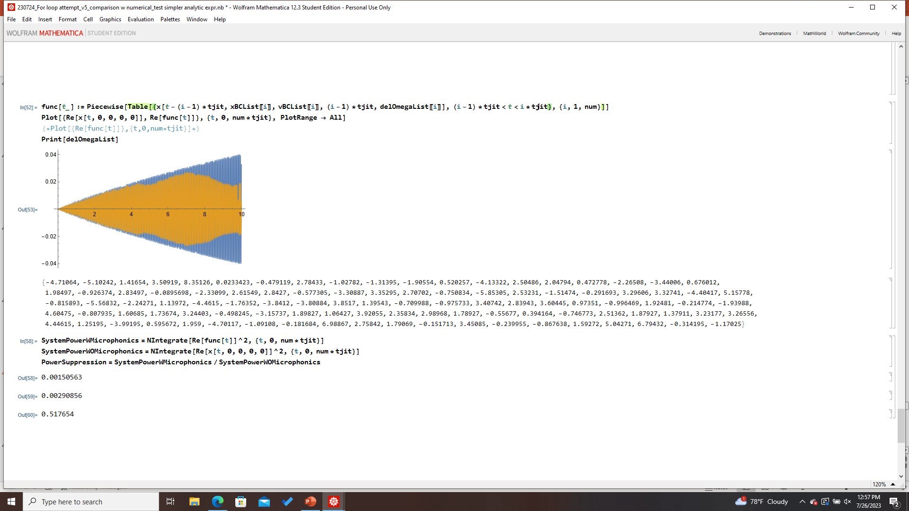

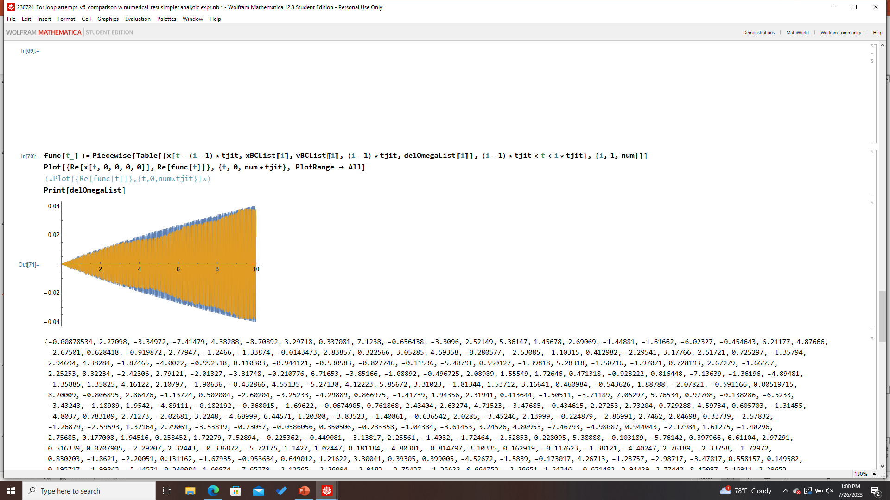





Testing Simplified Analytic Expressions
Damping component
Full analytic: w/ transient damping component
w/o transient or steady state damping component
w/o transient damping component
Percent error: 62.3%

Slide 16



Testing Simplified Analytic Expressions
Transient damping component
w/o transient damping component
w/ transient damping component
w/ linear order transient damping
Percent error: 0.07%
Percent error: 37.0%

Slide 17







Testing Simplified Analytic Expressions
Transient damping component
Testing whether the linear order transient damping approximation reproduces the long-time behavior
w/ full transient damping
w/ linear order transient damping
w/o transient component damping
Numerical Result
Computation time: basically identical

Slide 18








Testing Simplified Analytic Expressions
Transient x0/v0
Trial A
Trial B
Full Analytic
Simplified Transient Component
Percent error: ~ 30.4%
Percent error: ~ 6.0%

Slide 19










Testing Simplified Analytic Expressions
Steady State
Trial A
Trial B
Full Analytic
Simplified Steady-State Component
Percent error: ~3.5%
Percent error: ~2.2%
Simplified Steady-State and Transient Components
Percent error: ~24%

Slide 20
Summary
The analytic model is sensitive to all relevant parameters and closely agrees with the numerical model for a wide range of parameter spaces and microphonics regimes
A first look at the analytic model using Dark SRF experimental parameters gives a power suppression estimate of 0.05-0.2, significantly enhanced compared to the conservative estimate of ~10⁻⁶
Some simplifications of the analytic model can be made to both the transient and steady state terms without significantly compromising the results
Next steps:
Try to develop an understanding of why this power suppression is larger than expected
Validate this result and demonstrate its robustness

Slide 21

















Sensitivity to tjit
tjit=0.03
Trial A
Trial B
Trial C
Trial D
Power Suppression (last 1%):
0.5226
0.0714
0.3369
0.6217
Ave=0.3882
tjit=0.05
Trial E
Trial F
Trial G
Trial H
0.07868
0.2435
0.1130
0.0517
Ave=0.1217
tjit=1
0.07522
0.03069
0.06121
0.07929
tjit=10
Ave=0.06160
0.013397
0.09948
0.06980
0.0009930
Ave=0.04592

Slide 22






Case Studies of Microphonics
{3,3,3,3,3,3}
{-3,-3,-3,-3,-3,-3}
{3,-3,3,-3,3,-3}
0.000271354
0.000266636
0.0144154
{2.34,0.628,1.247,0.296,1.893,0.989}
{2.34,-0.628,1.247,-0.296,1.893,-0.989}
{-2.34,0.628,-1.247,0.296,-1.893,0.989}
0.0305509
0.06136
0.06165

Slide 23


Power Accumulation On and Off Resonance
{0,10,10}
{0,10,0}

Slide 25



Testing Simplified Analytic Expressions
Simplified Tr and SS Components
Full analytic model

Slide 26


Deriving the Steady State Amplitude
Growth and decay terms

Slide 27

A Closer Look at Pure Alternating Systems
Tjit=1 (10 intervals) (-α, α,- α, α,…)
Tjit=1 (10 intervals) (α, 0,- α, α, 0, -α …)
Power Suppression: 0.0603
Power Suppression: 0.05478
Time Off Resonance: 100%
Time Off Resonance: 70%

Slide 28

A Closer Look at Pure Alternating Systems
Tjit=0.01 (1000 intervals)
Power Suppression: 0.57757
Percentage of Time Off-Resonance: 100%

Slide 29


Numerical Result: Pure Alternating System
Parameters:
omega0= omegaF=100
gamma=0.1
tjit=0.1
delOmega=5
Microphonics: (-α, α,- α, α,…)
Time: 10 s
# of intervals: 100
Power Suppression: 0.9877
Parameters:
omega0= omegaF=100
gamma=0.1
tjit=0.1
delOmega=5/-2
Microphonics: (5, -2,5, -2,…)
Time: 10 s
# of intervals: 100
Power Suppression: 0.0295

Slide 30

Analytic, Physical Model (2 min trial)
Parameters:
omega0= omegaF=1.3 GHz
gamma=0.04
tjit=0.03
delOmega=7.8 Hz
Time: 120 s
# of intervals: 2000
Microphonics: Fixed offset, 7.8 Hz
Power Suppression: (?)

